Slide 1

PEISS
Power-Efficient Infrared Security System
Carlos Granja Angulo - Photonics Science Engineering
Matthew Berasa - Computer Engineering
Andrew Forde - Electrical Engineering
Andrew Topliffe - Electrical Engineering
Group 12 CDR Spring 2025
Notes:
Andrew F

Slide 2




Carlos Granja Angulo - Photonics Science Engineering
Matthew Berasa - Computer Engineering
Andrew Forde - Electrical Engineering
Andrew Topliffe - Electrical Engineering
Notes:
Andrew F

Slide 3


Motivation & Background
Power Consumption Comparison:
Traditional security systems require constant high-power operation, typically consuming 5-15W per sensor unit
Camera-based systems with continuous recording can consume 15-30W per camera
PIR (Passive Infrared) sensors use less power but have higher false alarm rates
The LED-photodiode system has lower power consumption because:
LEDs are inherently energy-efficient light sources
Photodiodes require minimal power to operate
The processing can be optimized for minimal power usage
Regarding price comparisons:
Traditional CCTV systems typically cost $500-2000 per installation point
Professional PIR-based systems range from $200-1000 per sensor
High-end smart security systems can cost $1000-3000 for basic setups.
Notes:
Carlos

Slide 4
Engineering Requirements
Feature | Requirement
Detection range | 0.5-1 meter
Object detection accuracy | Accuracy of at least 80%
App Latency | Less than 2 seconds
Power consumption | Less than 2W
Wireless communication range | More than 5 meters indoors
Response Time to Object | Less than 20 seconds
Cloud storage for events and image capture | More than 3 days
Notes:
Andrew T

Slide 5
Optical Specifications
Component | Parameter | Specification
LED | Field of View | Minimum 40°
 | Wavelength range | 780 - 1000 nm
Photodiode | Field of View | Minimum 40°
 | Wavelength range | 780- 1000 nm
Lens | Focal Length | Less than 7 mm
Filter | Center wavelength | 780 - 1000 nm
Notes:
Carlos

Slide 6
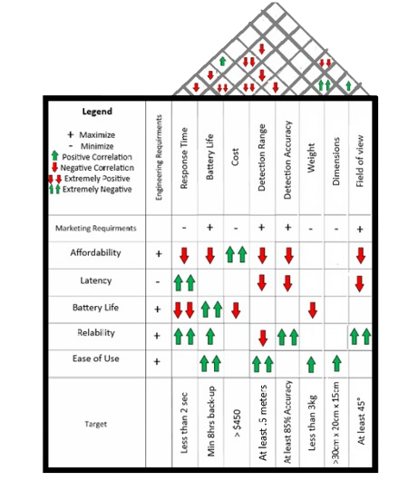
House of Quality

Slide 7
Goals and Objectives
BASIC:
Design an energy-efficient LED-Photodiode system through component selection
Develop high-speed detection with streamlined circuit layouts.
Create robust signal processing algorithms with specific wavelength selections and filtering techniques
Design a comprehensive mobile application with user interface elements and real-time data handling
Implement an AC power supply system with conversion circuits and voltage regulation systems
ADVANCED:
Design and integrate camera capture capabilities with efficient triggering mechanisms
Develop secure data storage solutions with encryption methods and access controls
Create a comprehensive backup power system
Implement wireless control systems with secure communication protocols
STRETCH:
Design advanced detection algorithms for human presence detection and pattern recognition
Develop enhanced range detection capabilities through optical system design
Create multiple LED-photodiode system with coordination protocols and synchronization methods
Notes:
Carlos

Slide 8
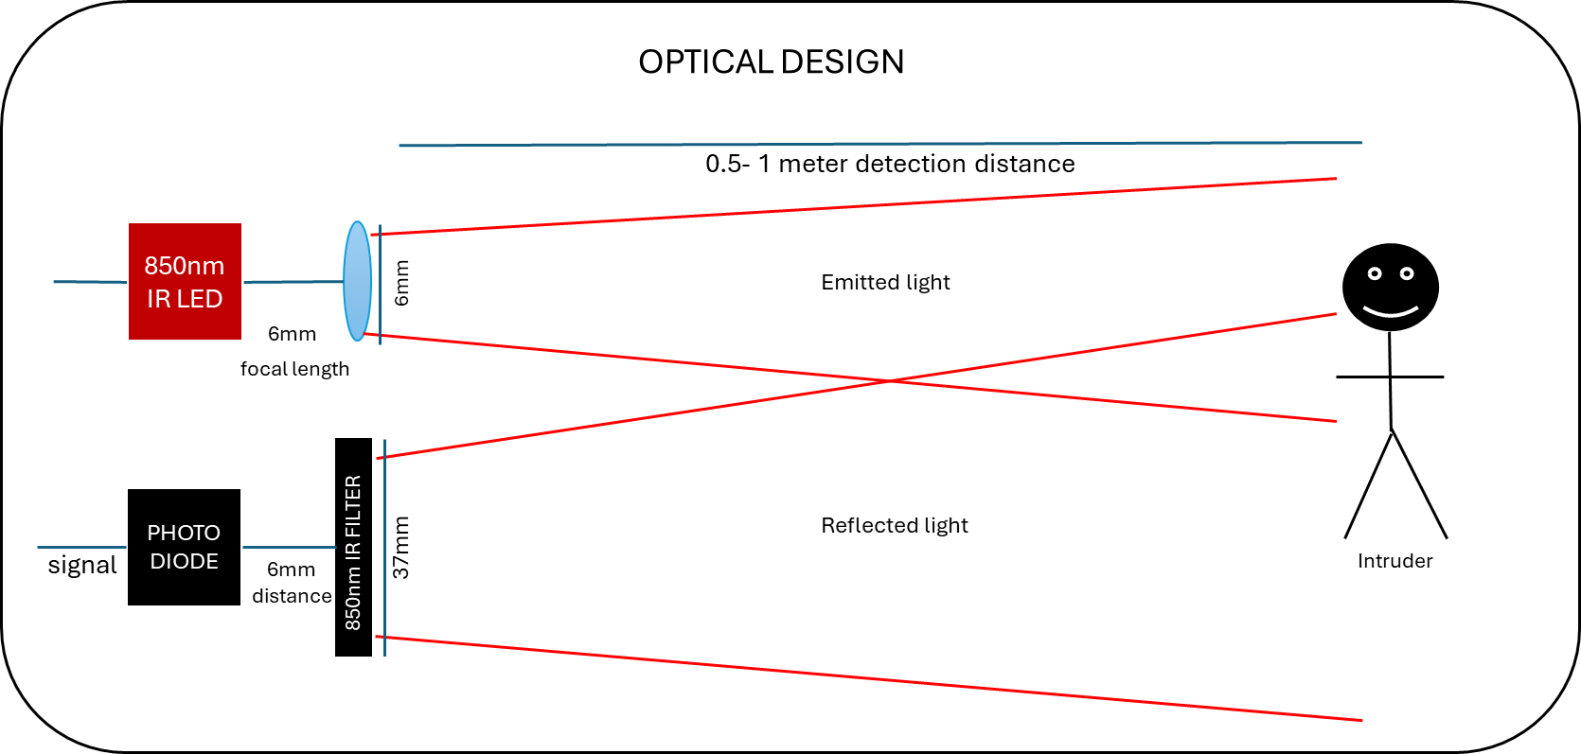
Optical Design and Calculations
For our IR LED radiant intensity of 70 mW/sr we calculated at our target distance of 1 meter. P = I/(4πr²) where I is initial intensity. It yields a power density of around 5.57mW/cm².
After object only 10% gets reflected living us 0.56 mW//cm².
Filter only passes 850nm with 90% intensity. Leaving us with 0.5mW//cm².
Photodiode with responsivity of 0.62 and active area of 1mm². The current received is Ip = 0.62 * 5*10^-3 * 10^-6 = 3.1 nA. Signal will be amplified using op-amp.

Slide 9
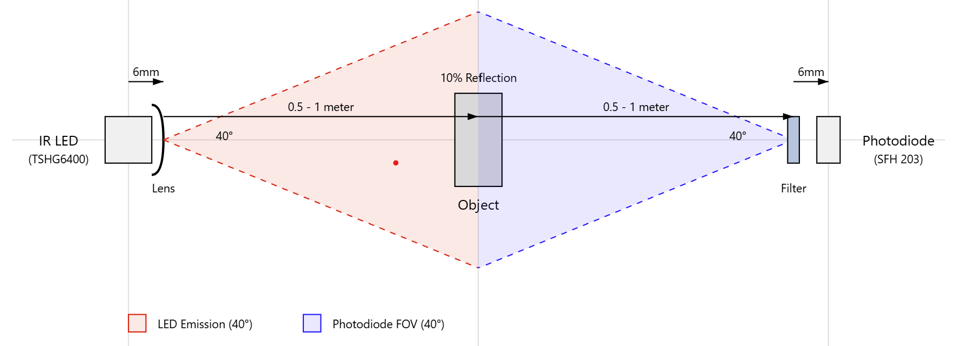
Optical Path Diagram
The IR LED will be emitting light that will go through a lens to increase its FOV. Light will travel in free space up to the object for 0.5 - 1 meter.
Reflected light at 10% intensity has to travel back another 0.5 - 1 meter go through filter (blocks ambient light) and be detected by photodiode.

Slide 10
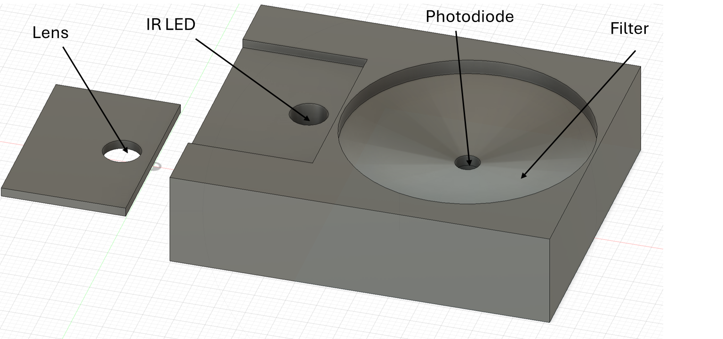
Optical Housing
The optical housing is 3D printed and ensures careful alignment of components.
Distance of 5cm between IR LED and photodiode and ensures 6mm distance for lens and filter.
Reduces ambient light interference and misalignment.

Slide 11
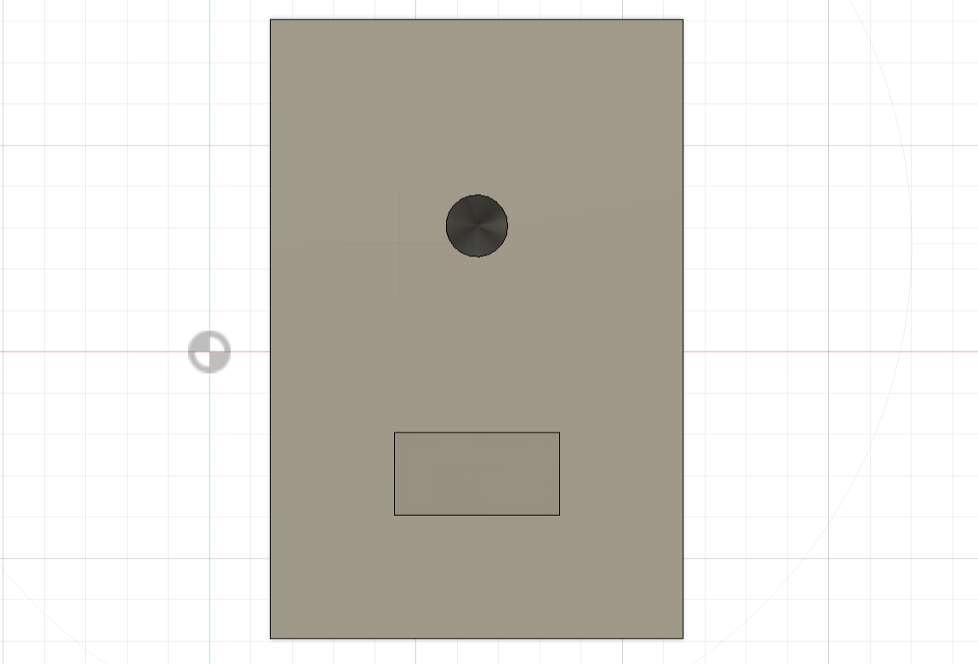
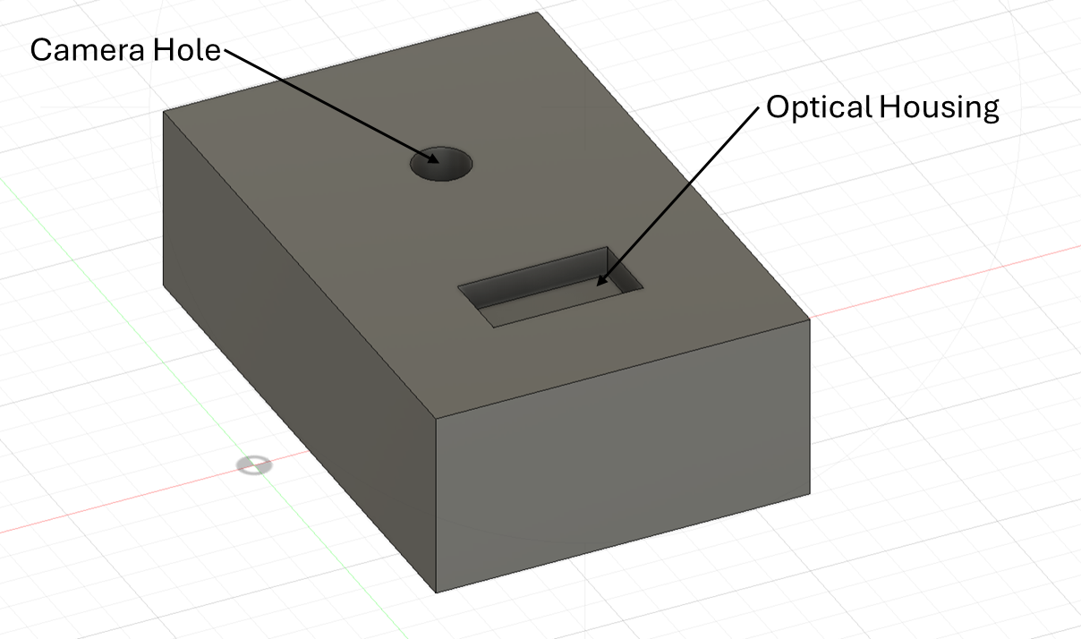

Visual concept of physical product
Front view
Back view

Slide 12
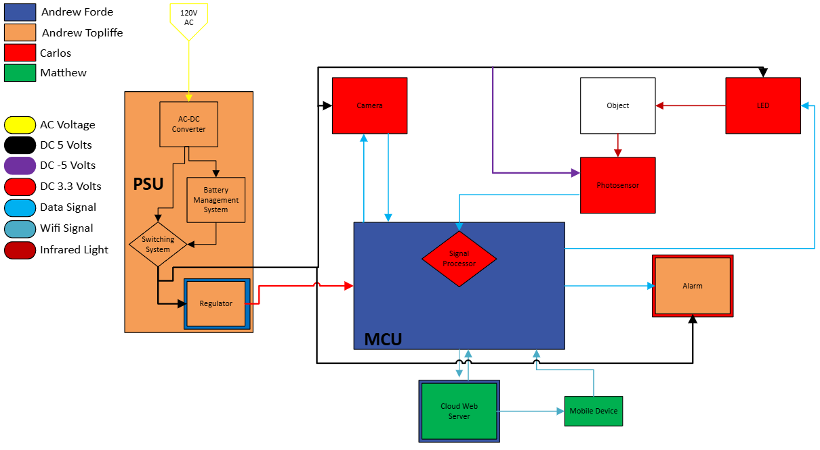
Hardware Diagram
Notes:
Andrew T

Slide 13
Electrical specifications
Minimal power consumption
  Reduces running cost and extending battery life
Minimum required voltage is 3.3V, ESP32 microcontroller
Additional hardware components operate at 5V or lower
  Ensures compatibility with backup battery
Optimized for minimal current draw, even during full operation
Notes:
Andrew T

Slide 14
Optical System part selection
Technology | Energy Efficiency (mW) | Price Range (USD) | Accuracy | Human Detection | Beam Angle (degrees) | Typical Range (m) | Human Safety
LiDAR | 1000-5000 | 100-500 | Very High | Excellent | 30-360 | 0.1-100+ | Generally Safe
Ultrasonic | 20-100 | 5-50 | Moderate | Limited | 15-60 | 2-10 | Very Safe
PIR | 0.01-0.05 | 2-20 | Low | Limited | 90-360 | 5-12 | Generally Safe
CMOS Camera | 500-2000 | 100-500 | High | Excellent | 60-110 | 10-50+ | Safe
LED-Photodiode | 1-50 | 10-50 | High | Good | 15-60 | 0.1-20 | Very Safe
The LED-Photodiode was selected because of its energy efficiency, low-price and high accuracy.
Notes:
Carlos

Slide 15
LED-Photodiode selection
LED: Selected Vishay for its wavelength which reflects better than 940nm, it's good radiant intensity, and affordability.
Photodiode: Selected SFH 203 for its peak wavelength sensitivity that matches our IR LED, it's good responsibility and low price.
Feature | Vishay TSHG6400 | Everlight IR333-A | OSRAM SFH 4550
Wavelength | 850nm | 940nm | 850nm
Radiant Intensity | 70 mW/sr | 48 mW/sr | 700 mW/sr
Viewing Angle | ±27° | ±20° | ±3°
Price | $0.85 | $0.75 | 0.95
Feature | Everlight PD333-3B/H0/L2 | Osram SFH 203 | Vishay TEMD5510FX01
Spectral Range | 400-1100 nm | 400-1100 nm | 430-1080 nm
Peak Sensitivity | 940nm | 850 nm | 540 nm
Responsivity | 0.5 A/W | 0.62 A/W | 0.65 A/W
Field of View | ±40° | ±20° | ±60°
Price | $0.80 | $0.90 | $1.20
Notes:
Carlos

Slide 16
Filter and Lens selection
Filter: Selected Green. L IR filter due to center wavelength, price and peak transmittance. Allow us to block ambient light while maintaining 90% transmittance.
Lens: Selected Edmund Optics #67-459 because of its focal length, giving us our desired FOV of 40° for IR LED while maintaining 99% transmittance.
Feature | Thorlabs FB940-10 | Edmund Optics #87-747 | MidOpt BP940 | Green.L 850nm IR Filter
Center Wavelength | 940 ± 2 nm | 950 ± 5 nm | 940 ± 8 nm | 850nm± 30 nm
Peak Transmittance | >90% | >90% | >90% | >90%
Blocking Range | 200-1100 nm | 200-1100 nm | 200-1100 nm | 200-1100 nm
Price (USD) | $95.00 | $49.00 | $35.00 | $20.99
Feature | Edmund Optics #33-019 | Thorlabs LA1540-B | Edmund Optics #67-459 | Xiaomi Plano convex lens
Focal Length | 25 mm | 15 mm | 6 mm | 20 mm
Transmittance | 99% | 99% | 99% | 95%
Price (USD) | $12.50 | $25.84 | $38.50 | $5.99
Notes:
Carlos

Slide 17
Camera
Feature | OV2640 | OV5640 | OV7670
Resolution | 2MP (1600x1200) | 5MP (2592x1944) | VGA (640x480)
Interface | SCCB (I2C) | MIPI, DVP | SCCB (I2C)
Power Consumption | ~60mW active | ~140mW active | ~30mW active
Wake-up Time | ~300ms | ~300ms | ~100ms
Low Light Performance | Good | Very Good | Fair
Size | 8.5 x 8.5 mm | 7.1 x 6.5 mm | 8 x 8 mm
Price (Approx.) | $20 | $15 | $5
We choose the OV2640 because it will be able to output an image at a better resolution without consuming much more power than the competitors.
Notes:
Andrew F

Slide 18
Alarm Technology Selection
Magnetic Buzzer was chosen due to it having the loudest dB while at a functioning operating voltage for the system
Alarm | dB Loudness | Size (Diameter) | Operating Voltage | Current Consumption
Piezo Buzzer | 70-85 dB | 10-30 mm | 3-12 V | 5-30 mA
Magnetic Buzzer | 80-100 dB | 10-30 mm | 3-5 V | 30-100 mA
Mini Siren | 110-120 dB | 30 -50 mm | 12 V | 100-500 mA

Slide 19
MCU vs FPGA
MCU Advantages | FPGA Advantages
Cost | Speed
Ease of Use | Reconfigurability
Power Consumption | Hardware Design
Form Factor | Parallel Processing
Embedded Applications | User Control
Due to our project being placing a focal point on power consumption, we decided to go with a MCU over a FPGA.
Notes:
Andrew F

Slide 20
MCU Comparison
Microcontroller | ESP32-WROOM | MSP430 | Arduino Uno R4 | Raspberry Pi Pico W | STM32F4
CPU | Xtensa 32-bit LX6 Dual-Core | 16-bit RISC | 32-bit ARM Cortex-M4 | 32-bit ARM Cortex-M0+ | 32-bit ARM Cortex-M4
Clock Speed | 160-240 MHz | 16 MHz | 48 MHz | 133 MHz | 168 MHz
Memory (Flash and RAM) | 4 MB Flash, 520 KB SRAM | 16 KB Flash, 512 B RAM | 256 KB Flash, 32 KB RAM | 2 MB Flash, 264 KB RAM | 512 KB Flash, 192 KB RAM
GPIO Pins | 48 GPIO Pins | 24 GPIO Pins | 20 GPIO Pins | 26 GPIO Pins | Typically 80 GPIO Pins, can reach up to 114
Communication | UART, SPI, I2C, Wi-Fi, Bluetooth | UART, SPI, I2C | UART, SPI, I2C, USB, Wi-Fi, Bluetooth | UART, SPI, I2C, USB, Wi-Fi, Bluetooth | UART, SPI, I2C, CAN, Ethernet
Operating Voltage | 3.3V | 1.8V-3.6V | 3.3V or 5V | 3.3V | 1.8V-3.6V
USB Support | Yes | No | Yes | Yes | Yes
PWM | Yes | Yes | Yes | Yes | Yes
Cost | $5-$10 - Dev Board $1-$2 - Chip | $11.99 - Dev Board $2.19 - Chip | $27.50 - Dev Board $6.99 - Chip (RA4M1) | $4 - Dev Board $0.70 - Chip (RP2040) | $9.44 - Chip and Dev Board
IoT Capabilities | Yes | No | Yes, with integration | Yes, with integration | No
With IoT capabilities being an emphasis, we were left with three choices out of the 5. Out of the three the ESP32 was the strongest performer.
Notes:
Andrew F

Slide 21
Power Requirements for Hardware
All hardware components in parallel of each other
Absolute max current ~950mA
Hardware | Model | Voltage | Current | Quantity | Total Power
MCU | ESP32 | 3.3V | ≤ 600mA | 1 | 1.98W
Camera | OV2640 | 5V | 70mA active | 1 | 350mW active
Alarm | CMT-8540S-SMT-TR | 5V | 150mA | 1 | 750mW
LED | TSHG6400 | 5V | ~90mA | 1 | 450mW
Relay Coil | J104B2C5VDC.20S | 5V | 40mA | 1 | 200mW
Total |  |  | ~950mA |  | 3.73W

Slide 22
Power Converter
The IMR-15-5 was chosen for its current output and low cost
Model | IMR-15-5 | IMR-03-5 | RAC10-05SK/277 | RAC04-05SC/277
Input Voltage | 85 ~ 305 VAC, 120 ~ 430 VDC | 85 ~ 305 VAC, 120 ~ 430 VDC | 80 ~ 305 VAC | 80 ~ 305 VAC
Output Current | 3A | 600mA | 2A | 800mA
Power | 15W | 3W | 10W | 4W
Package/ Case | 4-DIP Module | 26-SMD Module, 14 Leads | 4-DIP Module | 7-DIP Module, 6 Leads
Cost | $9.73 | $6.10 | $13.04 | $21.86
Notes:
Andrew T

Slide 23
Batteries
18650 has the best capacity, cost, and safest batteries for recharging
Model | 18650 | 2011 | BL3000F9031781S1PCNC | BGN2500
Chemistry | Li-Ion | Lithium-Ion Polymer | Lithium-Ion Polymer | Nickel Cadmium
Output Voltage | 3.7V | 3.7 V | 3.7 V | 1.2 V
Capacity | 3.4Ah | 2Ah | 3Ah | 2.5Ah
Cost | $6.95 | $12.50 | $19.26 | $4.61
Notes:
Andrew T

Slide 24
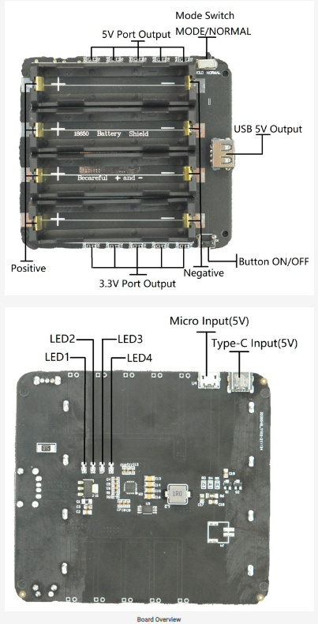
Battery Management System
DFR0969 4-way 18650 battery holder by DFRobot
built in overcharge and over-discharge protection
outputs at 5V 2A and 3.3V 1A.
We will only be using the 5V output for simplicity
Notes:
Andrew T

Slide 25
Priority Switching System
Switching between two power sources can be achieved by the use of a relay
Main source powering relay and in NO position, backup source in NC position
Loss of main source causes relay to switch position, allowing backup source to be used
Model | 3385-AZ943-1CH-5DE-ND | ALQ105 | J104B2C5VDC.20S | JW2SN-DC5V
Max current | 10 A | 5 A (30 V DC) | 3 A | 5 A
Contact Configuration | SPDT (1 Form C) | SPDT (1 Form C) | DPDT (2 Form C) | DPDT (2 Form C)
Coil voltage | 5V DC | 5V DC | 5V DC | 5V DC
Cost | $1.09 | $1.45 | $1.77 | $2.97
Notes:
Andrew T

Slide 26
Power Regulation
To ensure a stable 3.3V from the PSU, a regulator will be used
A switching regulator will be used instead of linear regulator
Model | LM2575-3.3WT | LMR50410Y3FQDBVRQ1 | LM2575T-3.3/NOPB | LT8609AEDDM-3.3#PBF
Input Voltage Range | 4V-40V | 4V-36V | 4V-40V | 3V-42V
Output Current | 1A | 1A | 1A | 3A
Switching Frequency | 52kHz | 2.1MHz | 52kHz | 200kHz ~ 2.2MHz
Efficiency
Cost | $1.72 | $1.41 | $3.58 | $8.94
Notes:
Andrew T

Slide 27
List of Power Components Selection
Power Components:
IRM-15-5 : AC/DC Converter 5V 15W
18650 battery : 3.7V 3400mAh Lithium Ion
DFR0970 : Battery Holder for 18650 batteries, 4 Cell
J104B2C5VDC.20S : General purpose DPDT 3A 5V
LMR50410Y3FQDBVRQ1 : Buck Switching Regulator Fixed 3.3V 1A 1 Output
Notes:
Andrew T

Slide 28
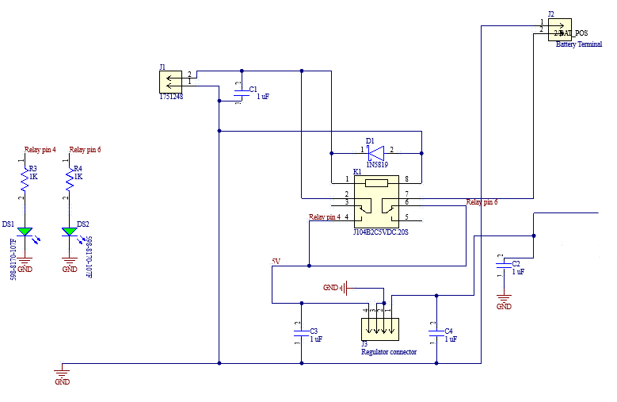
Switching System Schematic
Notes:
Andrew T

Slide 29
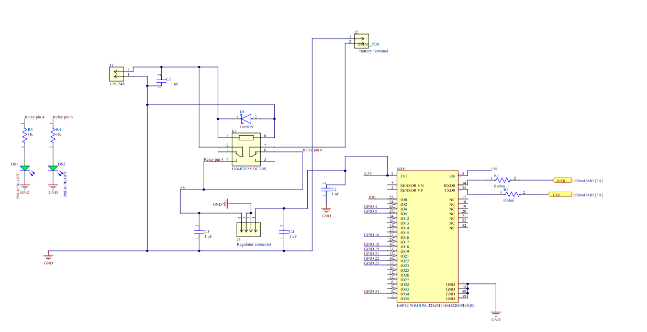
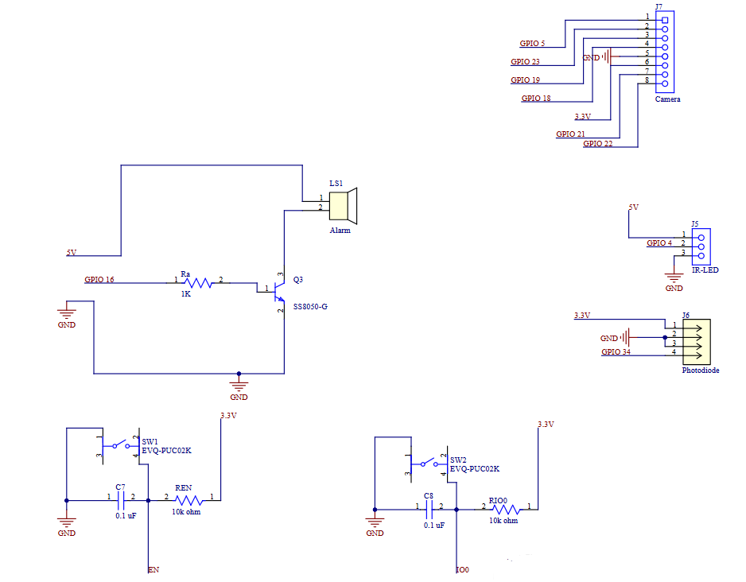
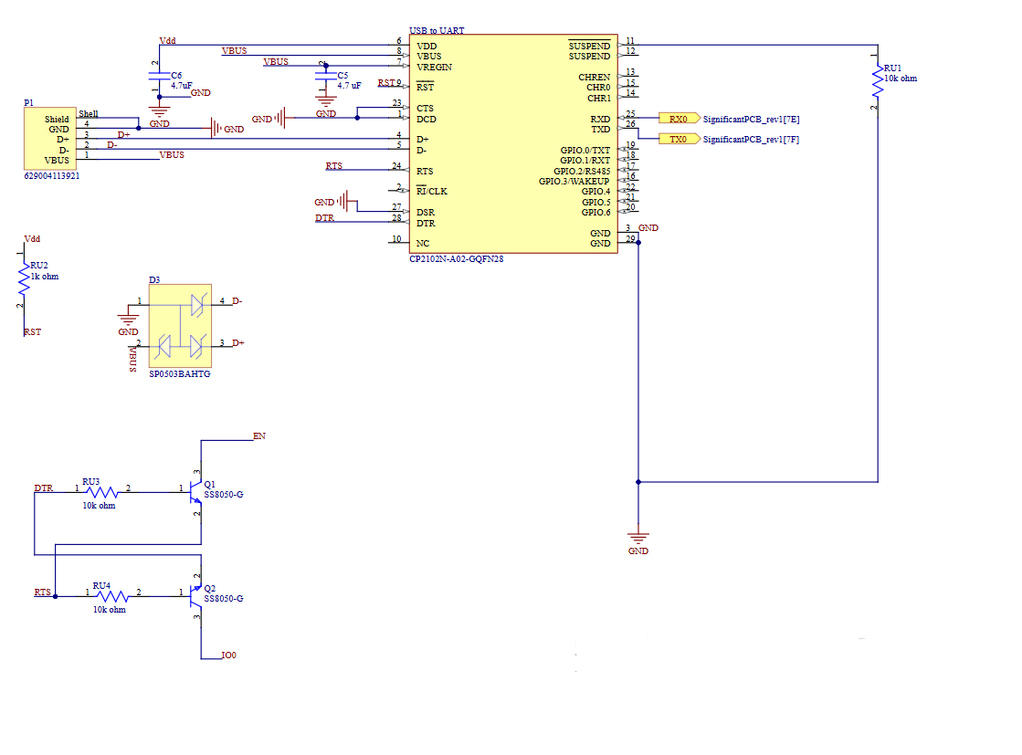
Main PCB Schematic
Notes:
Andrew F

Slide 30
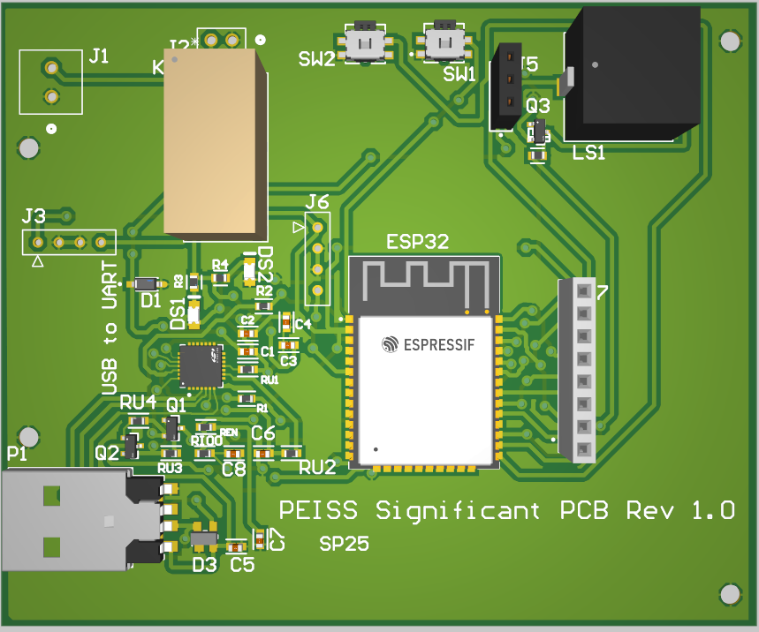
Main PCB
ESP32 chip
Magnetic buzzer alarm
J104B2C5VDC.20S Relay
Headers for connection to breakout boards
USB to UART bridge CP2102
Notes:
Andrew F

Slide 31
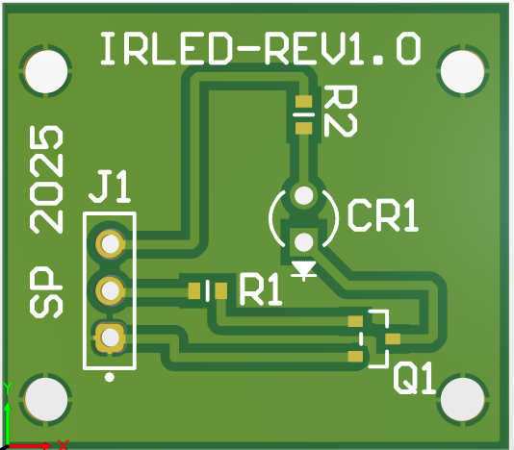
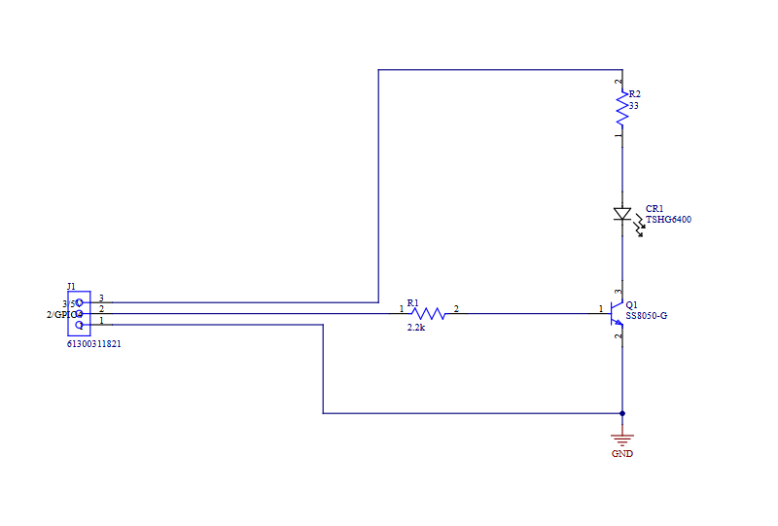
IR-LED Board
Infrared LED - TSHG6400
Supplied by 5V and driven using GPIO 4 and a SS8050-G NPN transistor.
Notes:
Andrew F

Slide 32
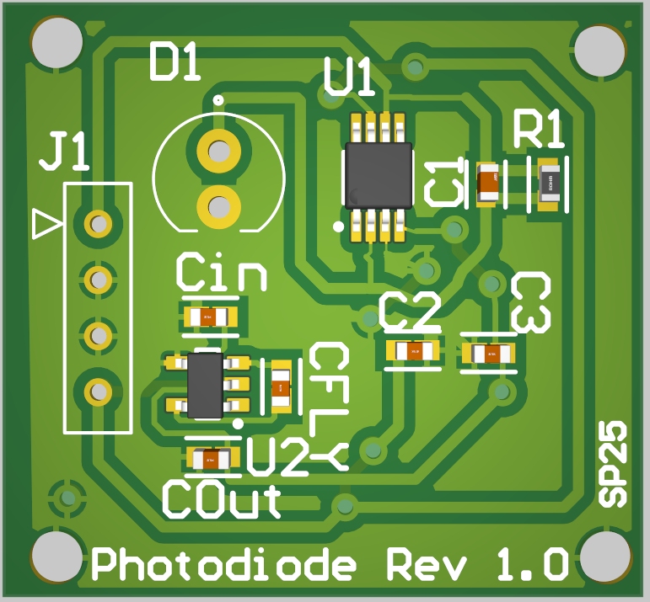
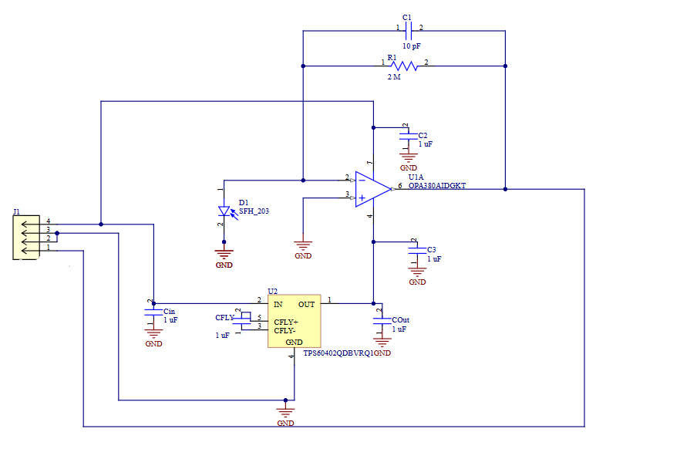
Photodiode Board
OPA380AIDGKT - Transimpedance amplifier to filter the raw analog signal from the photodiode.
TPS60402QDBVRQ1 - Charge pump inverter used to supply the negative rail of the op-amp.
J1 will be used to establish connection to the main PCB.
Notes:
Andrew F

Slide 33
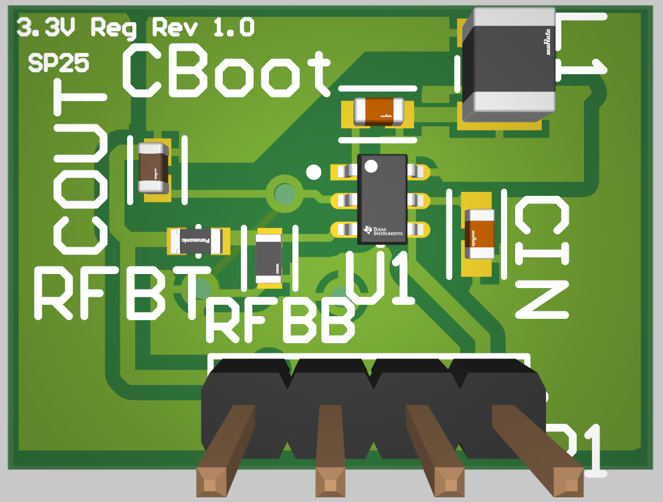
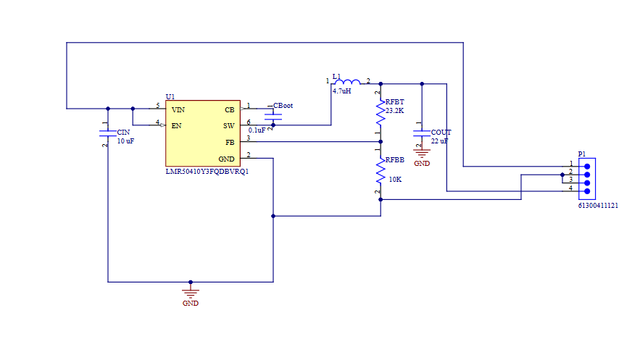
3.3V Regulator
LMR50410Y3FQDBVRQ1 - 3.3V-1A output
2 Layer PCB including a ground plane, input signal plane, and an output signal plane to maximize efficiency.
Notes:
Andrew F

Slide 34
Communication Protocol Selection
Protocol | UART | I2C | SPI | USB | Wi-Fi | Bluetooth | LoRaWAN
Connection | Serial | Serial | Serial | Wired | Wireless | Wireless | Wireless
Range | Short distance | Short distance | Short distance | Varying distance up to 9.8 ft | ~100 meters (330 ft) | ~100 meters (330 ft) | Up to 15 km in rural settings and 2-5 in urban
Power Consumption | Low (~5-10 mW) | Low (~1-20 mW) | Low to Moderate (~10-50 mW) | High - 4.5 W (max) | High (50-800 mW) depending on activity | Low (~1-10 mW) | Low (~50-100 µW in idle, ~10-50 mW during transmission)
Transfer Speed | 9600 bps | 100 Kbps, up to 3.4 Mbps if in high speed mode | 10-20 Mbps | 20 Gbps (USB 3.0) | (450-600 Mbps) -2.4 GHz | BLE - 2 Mbps Classic - 1Mbps | 0.3-50 Kbps
UART will be used to program the ESP32.
SPI is the serial communication utilized by the OV2640 camera module.
Wi-Fi will be used to wirelessly communicate between our ESP32 and server hosting the UI.

Slide 35
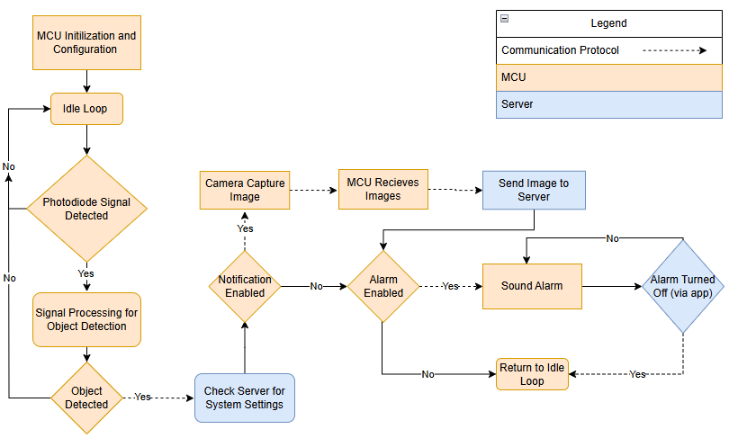

Software MCU Programming
Arduino IDE
C language
Notes:
Matthew

Slide 36
Software Backend (Server)
 | Amazon Web Services | Digital Ocean | Heroku | Google Cloud Platform
Scalability | Highly Scalable | Moderate Scalability | Low Scalability | Highly Scalable
Latency | Very Low Latency | Low Latency | Moderate Latency | Very Low Latency
Uptime Reliability | Very High Reliability | Very High Reliability | Moderate Reliability | Very High Reliability
Ease of Use | Moderate Complexity | Low Complexity | Very Low Complexity | Moderate Complexity
DigitalOcean was chosen due to low complexity and provided high enough reliability and latency for this project
Notes:
Matthew

Slide 37

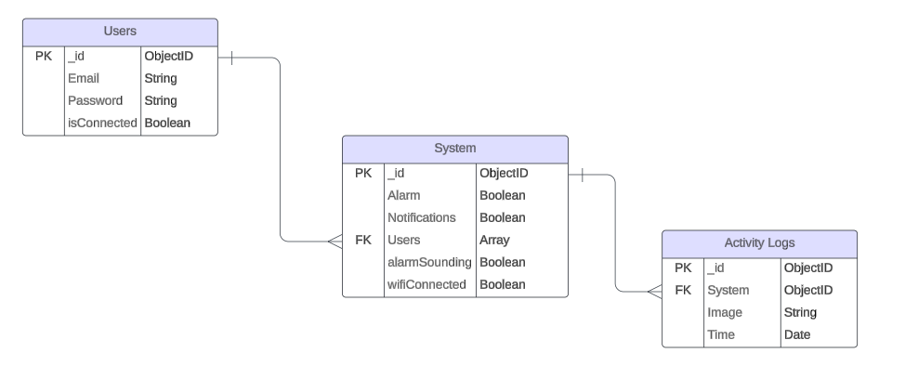
Software Backend (Database)
MongoDB
NoSQL Database
  Faster than other NOSQL DB
  Lot of Past Experience
JSON-like Format Storage
  Easier integration with APIs
Notes:
Matthew

Slide 38

Software Backend (API)
Node.js
Provides the environments to run Javascript to server
Express.js
Framework that allows defining routes for handling HTTP requests (POST, GET, DELETE, PUT)
Notes:
Matthew

Slide 39
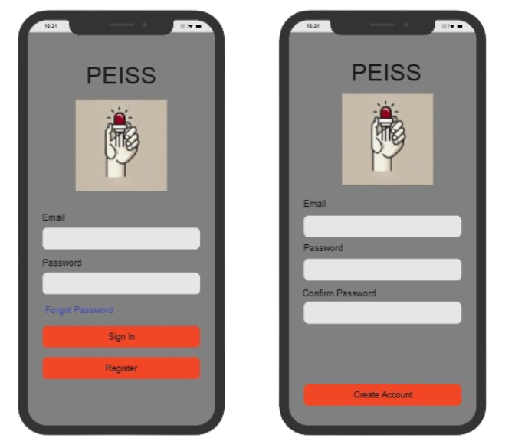

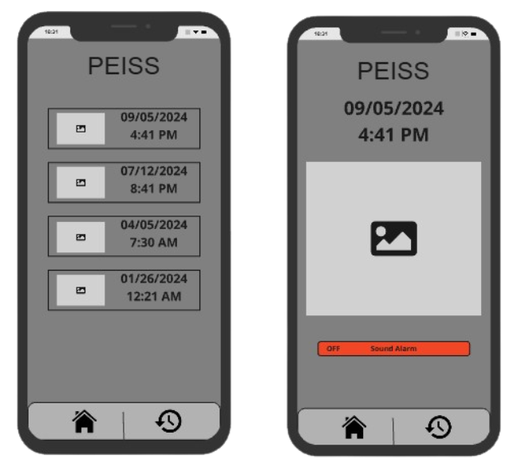
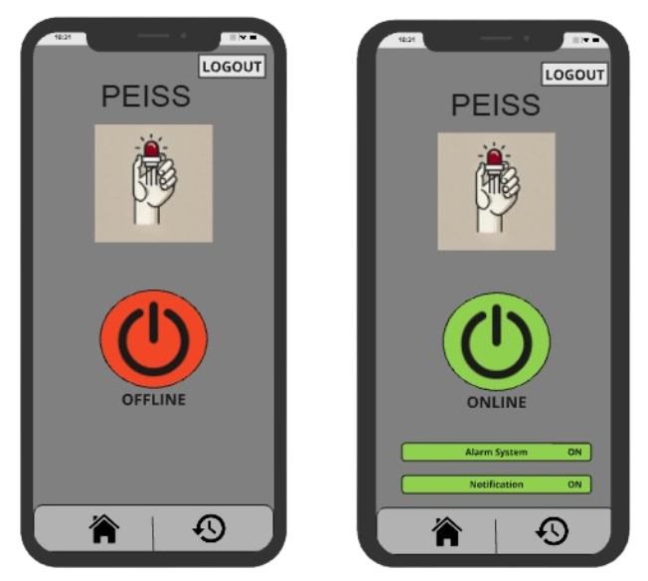
Software Frontend
Flutter
App Framework
Single Codebase for Cross-Platform
Same UI for all Platforms
Notes:
Matthew

Slide 40
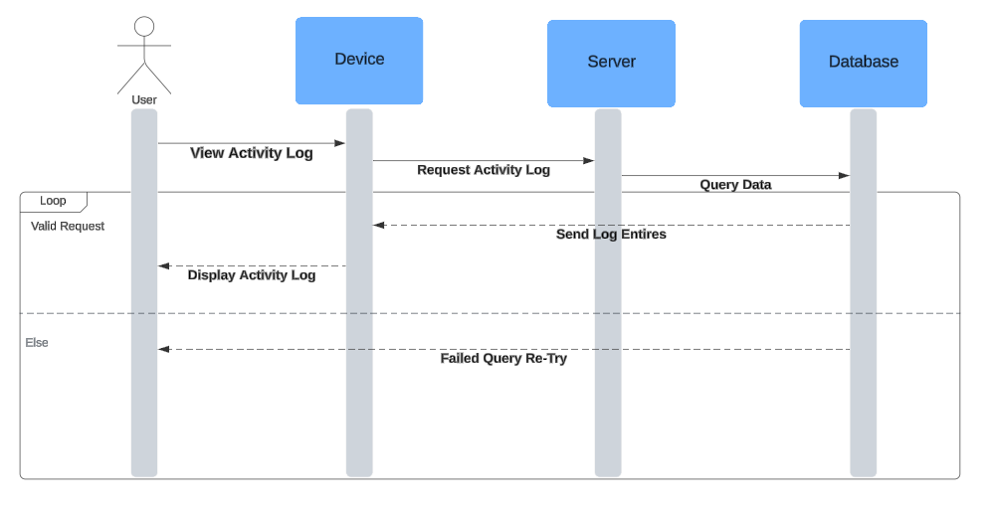
Sequence Diagram Example
Diagram to display the need for a cloud server. (Ex. Viewing Activity Logs)
Every action done in app needs server as intermediary to database
Notes:
Matthew

Slide 41
Software Testing
Initial software testing focused on backend API validation using SwaggerHub. Ensuring each endpoint functioned correctly.
Frontend development progressed concurrently, with functionality tested using an emulator in Android Studio.
The ESP32 software was tested alongside hardware integration to ensure seamless system operation.
Notes:
Matthew

Slide 42
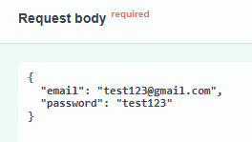
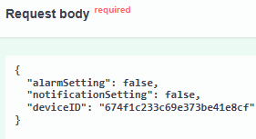

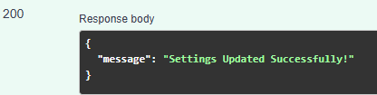
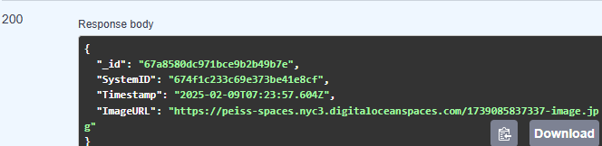
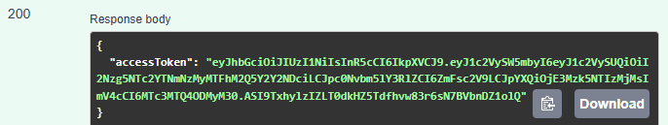
Backend Testing
SwaggerHub Documentation: https://app.swaggerhub.com/apis/peiss2025/PEISS/1.0.0
Each endpoint was individually tested to validate its functionality.
The examples below demonstrate the testing process, which involved sending a test JSON request and verifying a 200 OK response to confirm correct operation.
Ex. Login Ex. updateSettings Ex. getSpecificLog

Slide 43
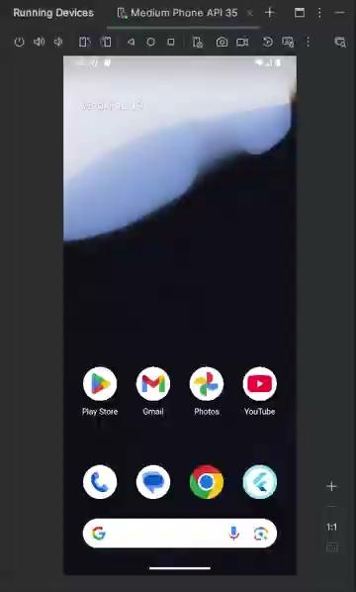
User Interface Testing
Testing Approach: Conducted alongside frontend development to ensure real-time validation.
Key Focus Areas:
API frontend calls to ensure seamless communication between app and server
User interface responsiveness and functionality
Testing Environment: Android Studio Emulator
Example Video: Demonstrates the user experience while showing the features of each screen
Login -> Home Screen -> Activity Logs -> Detailed Log

Slide 44
Hardware Testing
All demo testing was done with through hole components and breadboarding
Through-hole hardware components were tested multiple times in the senior design lab to verify proper functionality and ensure accurate results
Surface-mount components will require additional testing once the PCB arrives. However, comparable through-hole components were used during initial testing to validate performance
Optical hardware testing was conducted in the senior design lab, with feedback and guidance from Dr. Weeks to optimize performance and results
Notes:
Andrew T

Slide 45
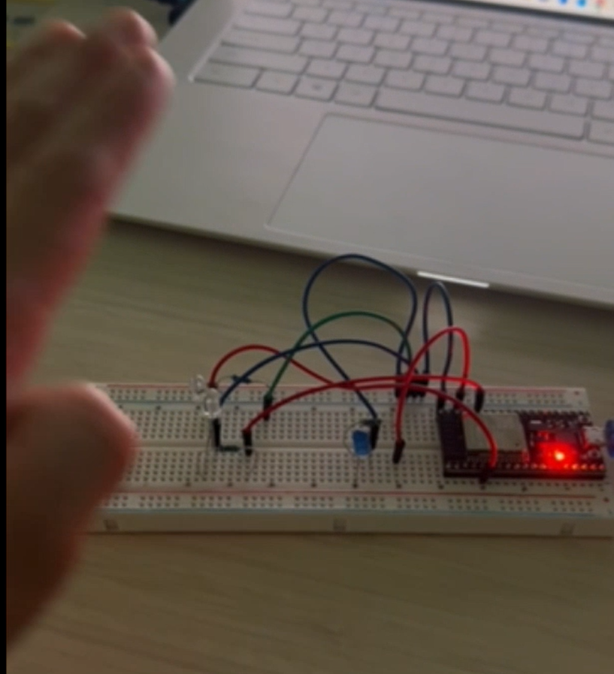
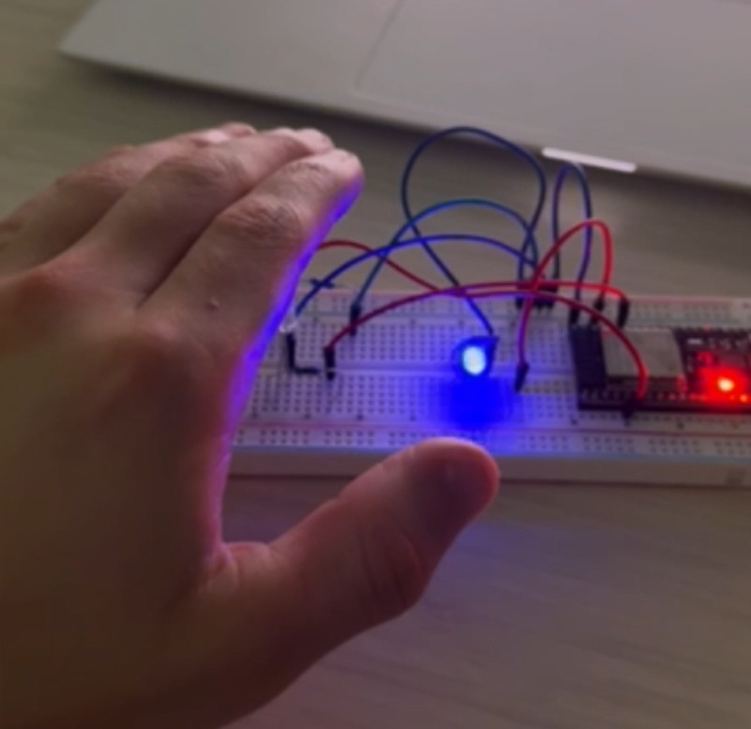
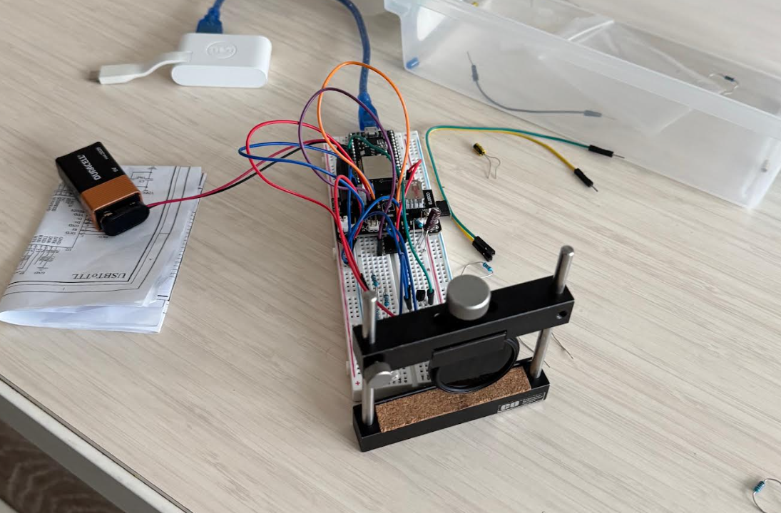
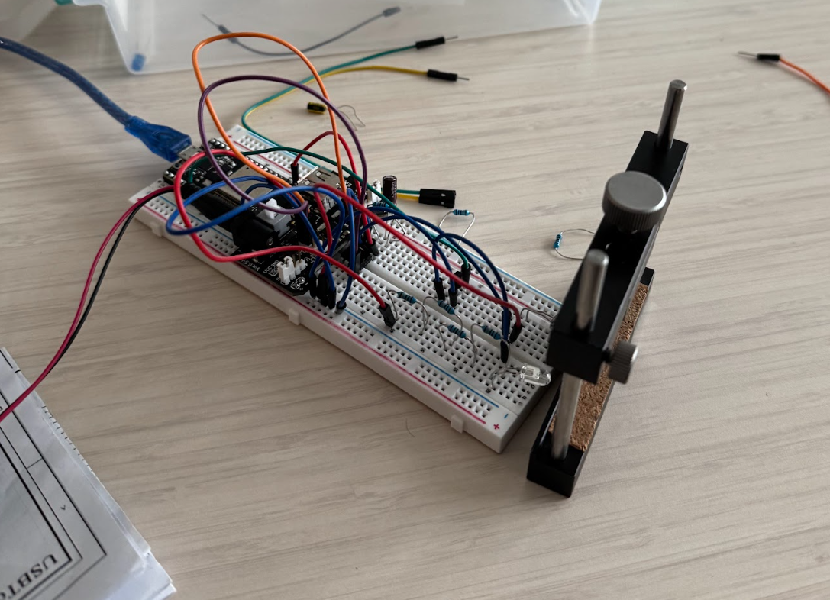

Optical Hardware Testing
1/6/25, 5 cm max detection range: LED-photodiode connected directly to ESP-32. LED was not getting enough power. First design is not practical even if it works.
1/15/25, 10 cm max detection range: LED connected to 5V supply instead, photodiode directly to ESP-32. Lots if light interference, photodiode is getting low signal. We can’t get longer range.

Slide 46
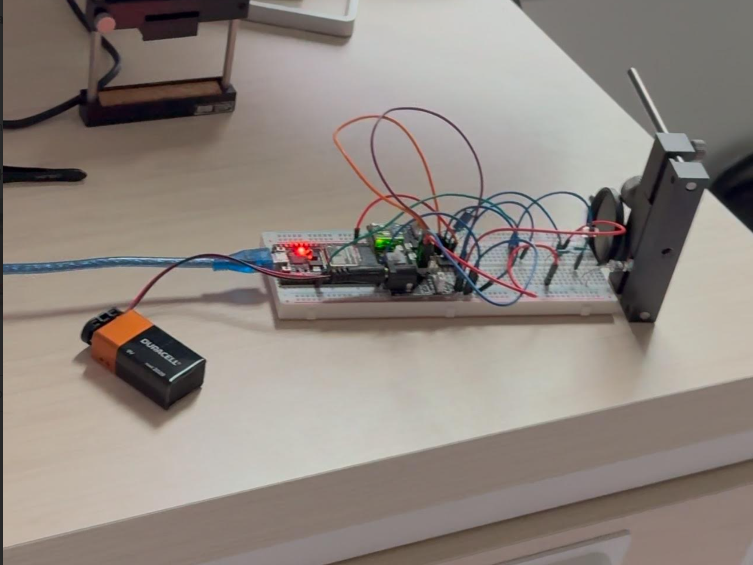
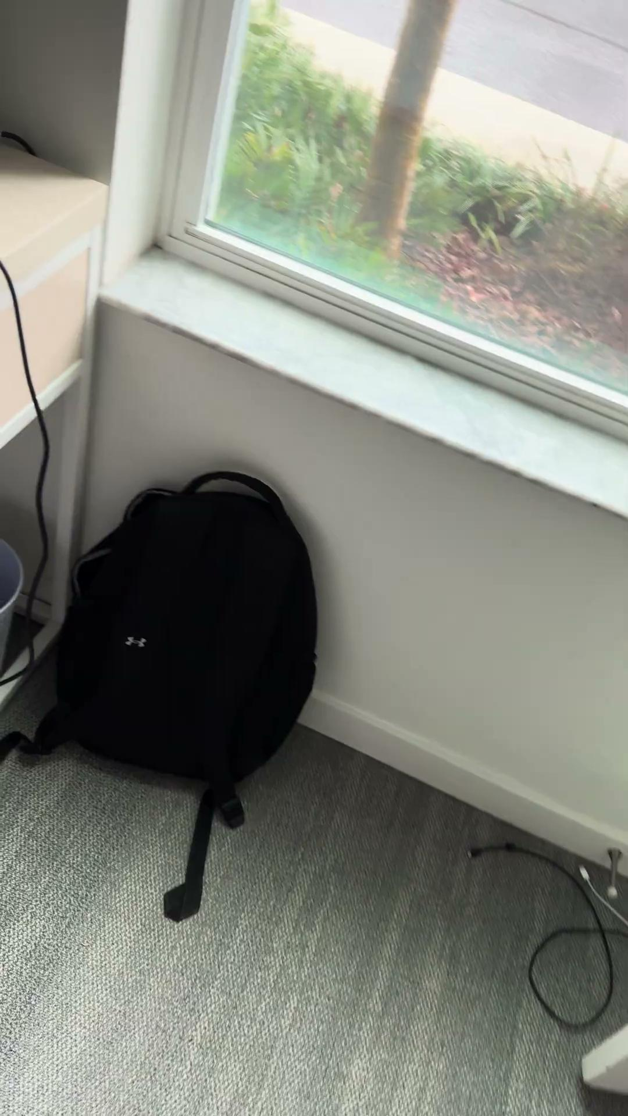
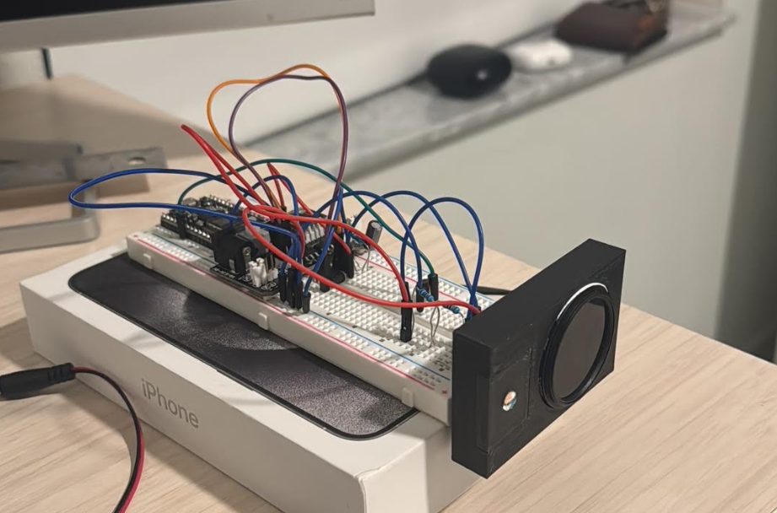
Optical Hardware Testing
1/22/25, 15 cm max detection range: LED supplied with 5V and using transistor for modulation. Adding lens and filter. Components are loose, photodiode gets low signal. We are struggling to get more range.
1/30/25, 20 cm max detection range: Adding op-amp to photodiode for signal amplification. Components are loose in first housing, improved photodiode signal but high noise due to bad op-amp.

Slide 47
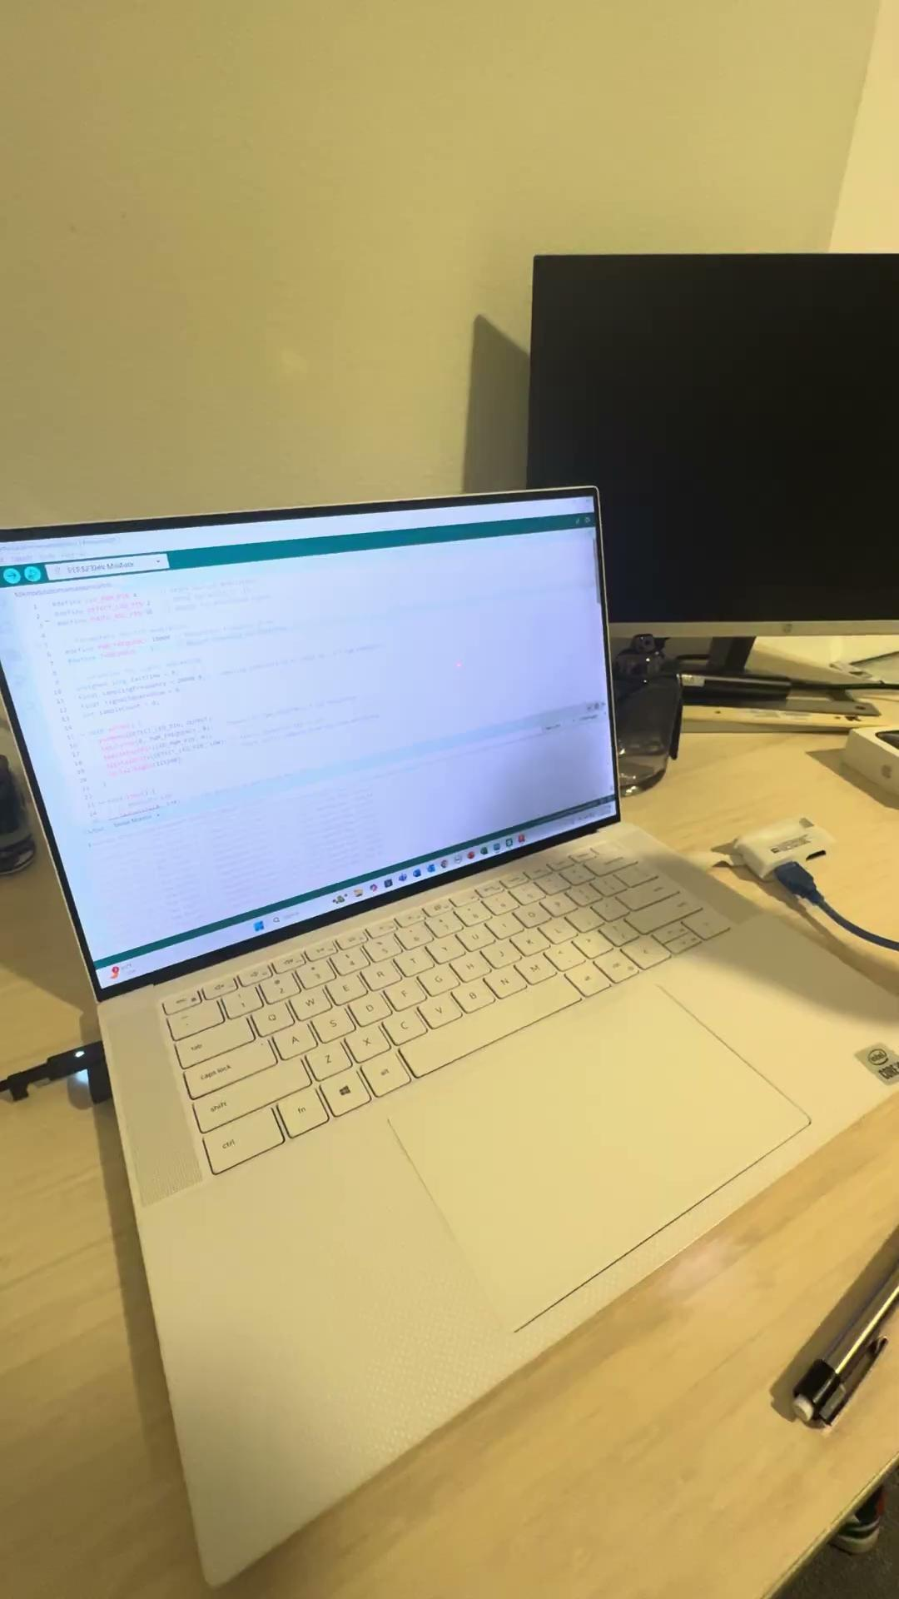
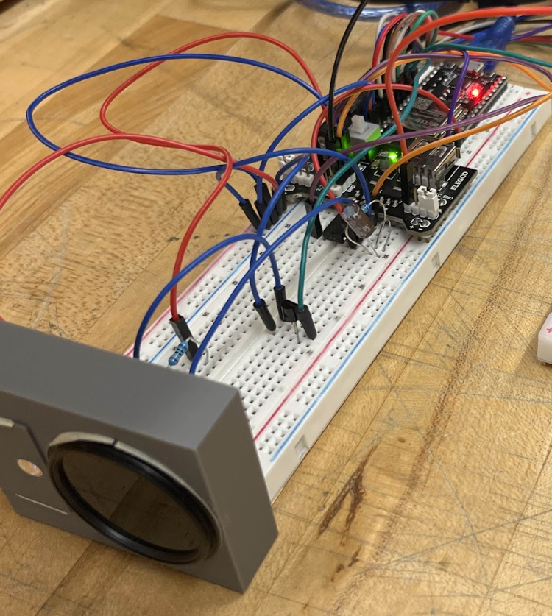
Optical Hardware Testing
2/3/25, 25 cm max detection range: Adding improved housing for optical components ensuring alignment and reducing ambient light interference. Increased current supplied to IR-LED.

Slide 48
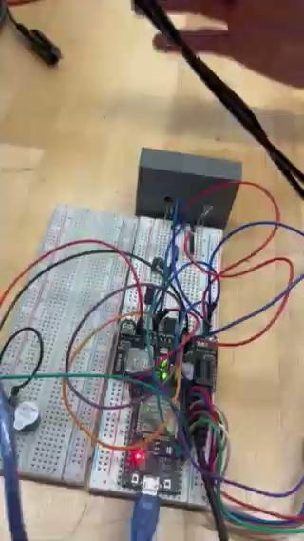
Alarm Testing
This test verifies the alarm response logic and confirms the system correctly initiates an audible alert.

Slide 49
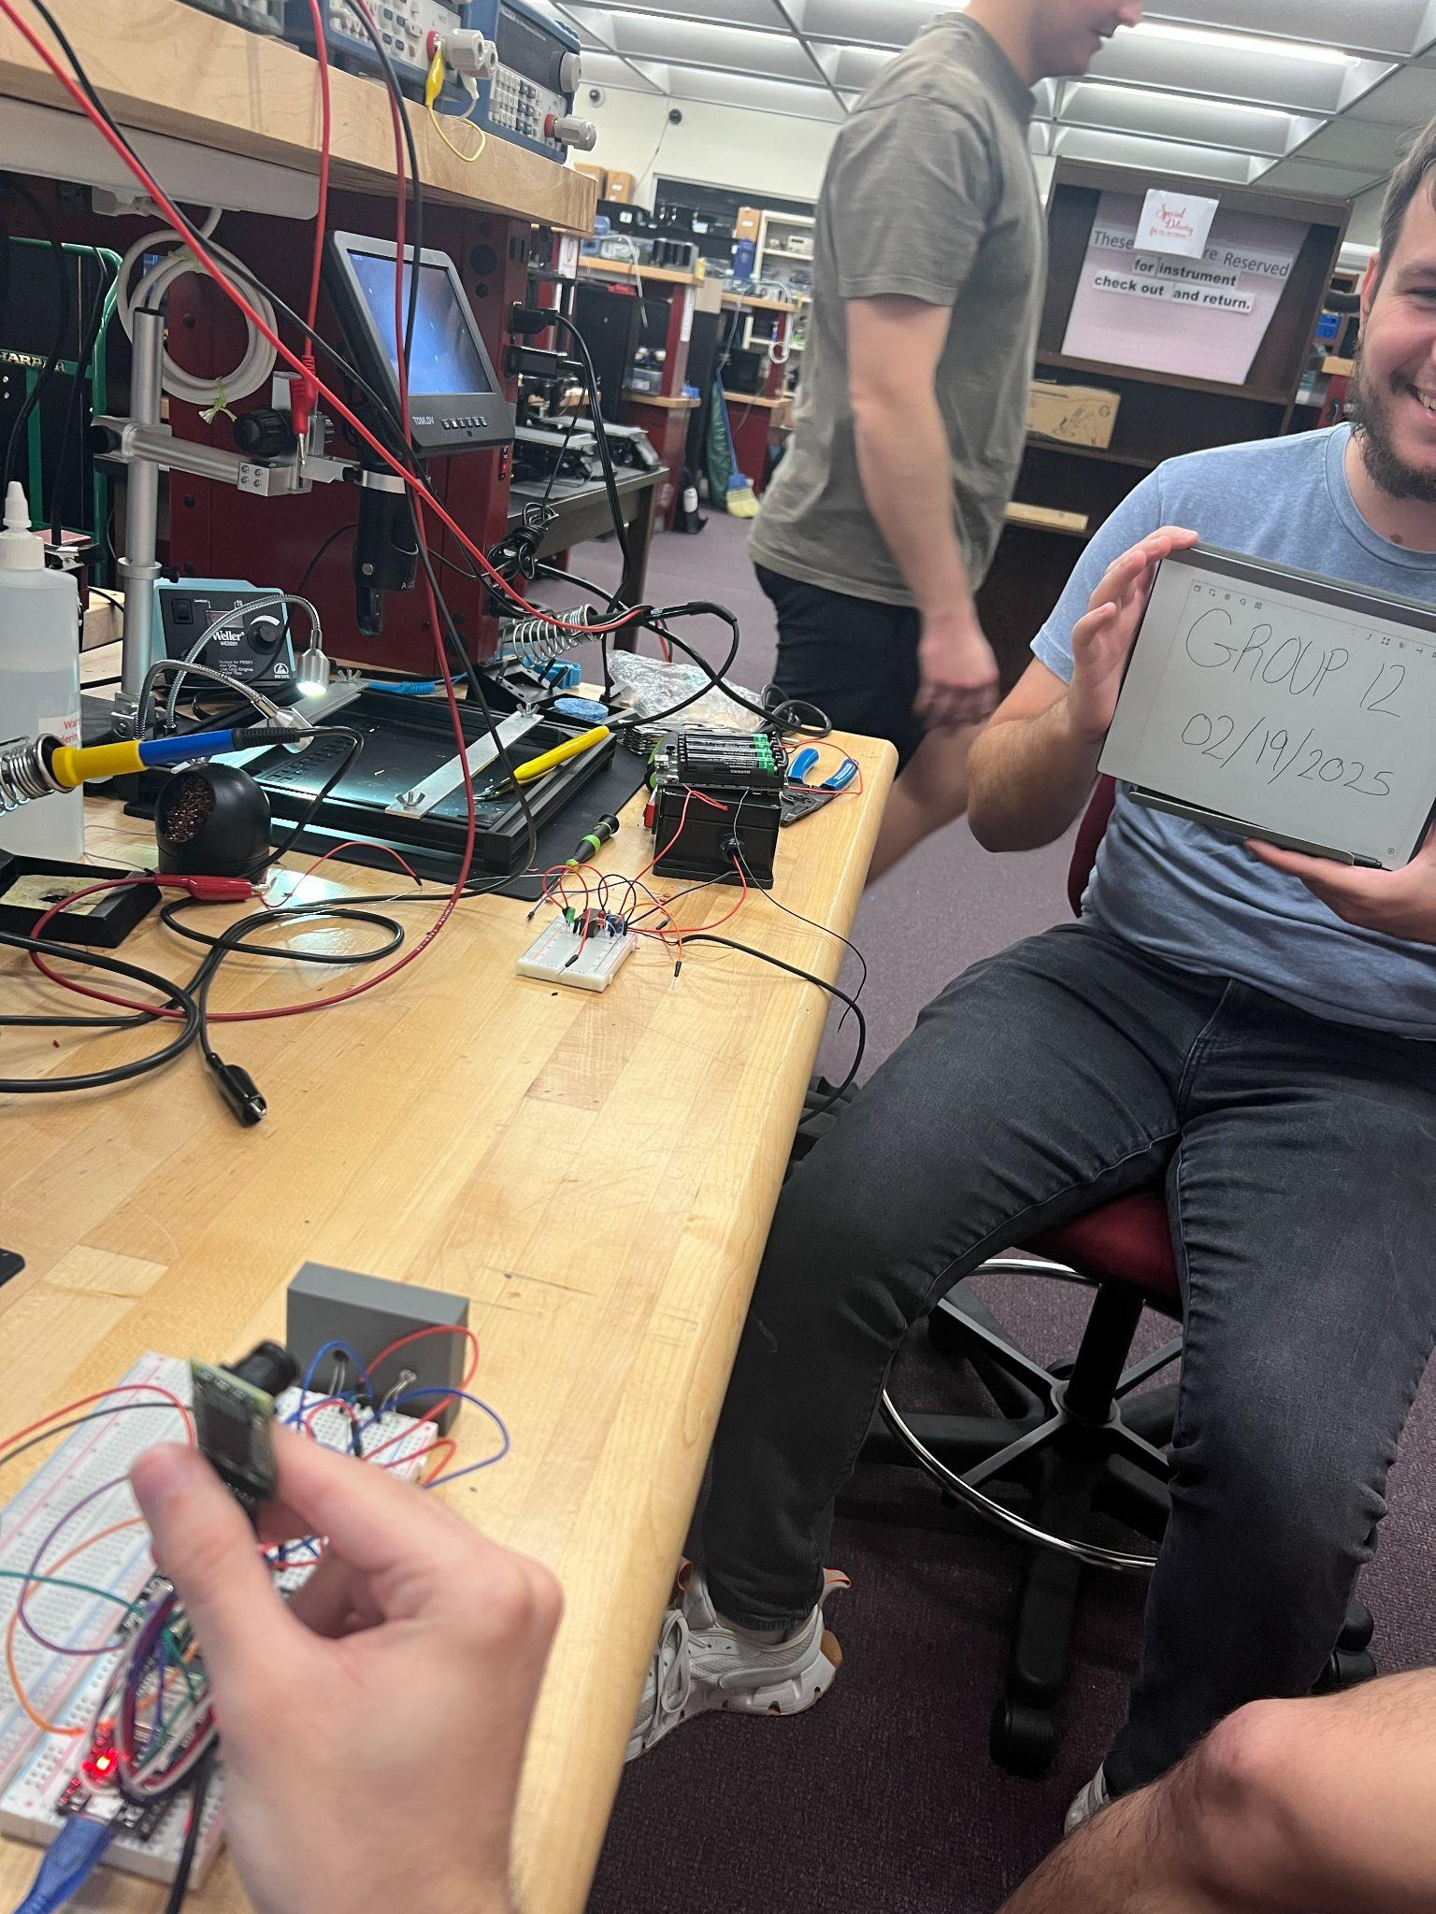
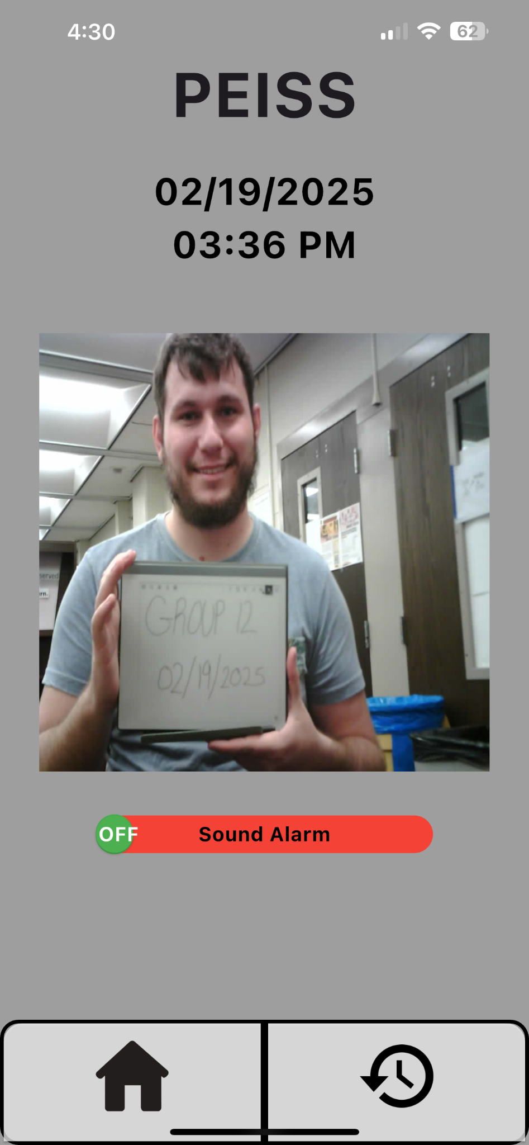
Camera Testing
Verified proper camera initialization
Ensured the camera successfully captured images
Tested SPI communication between the ESP32 and camera

Slide 50
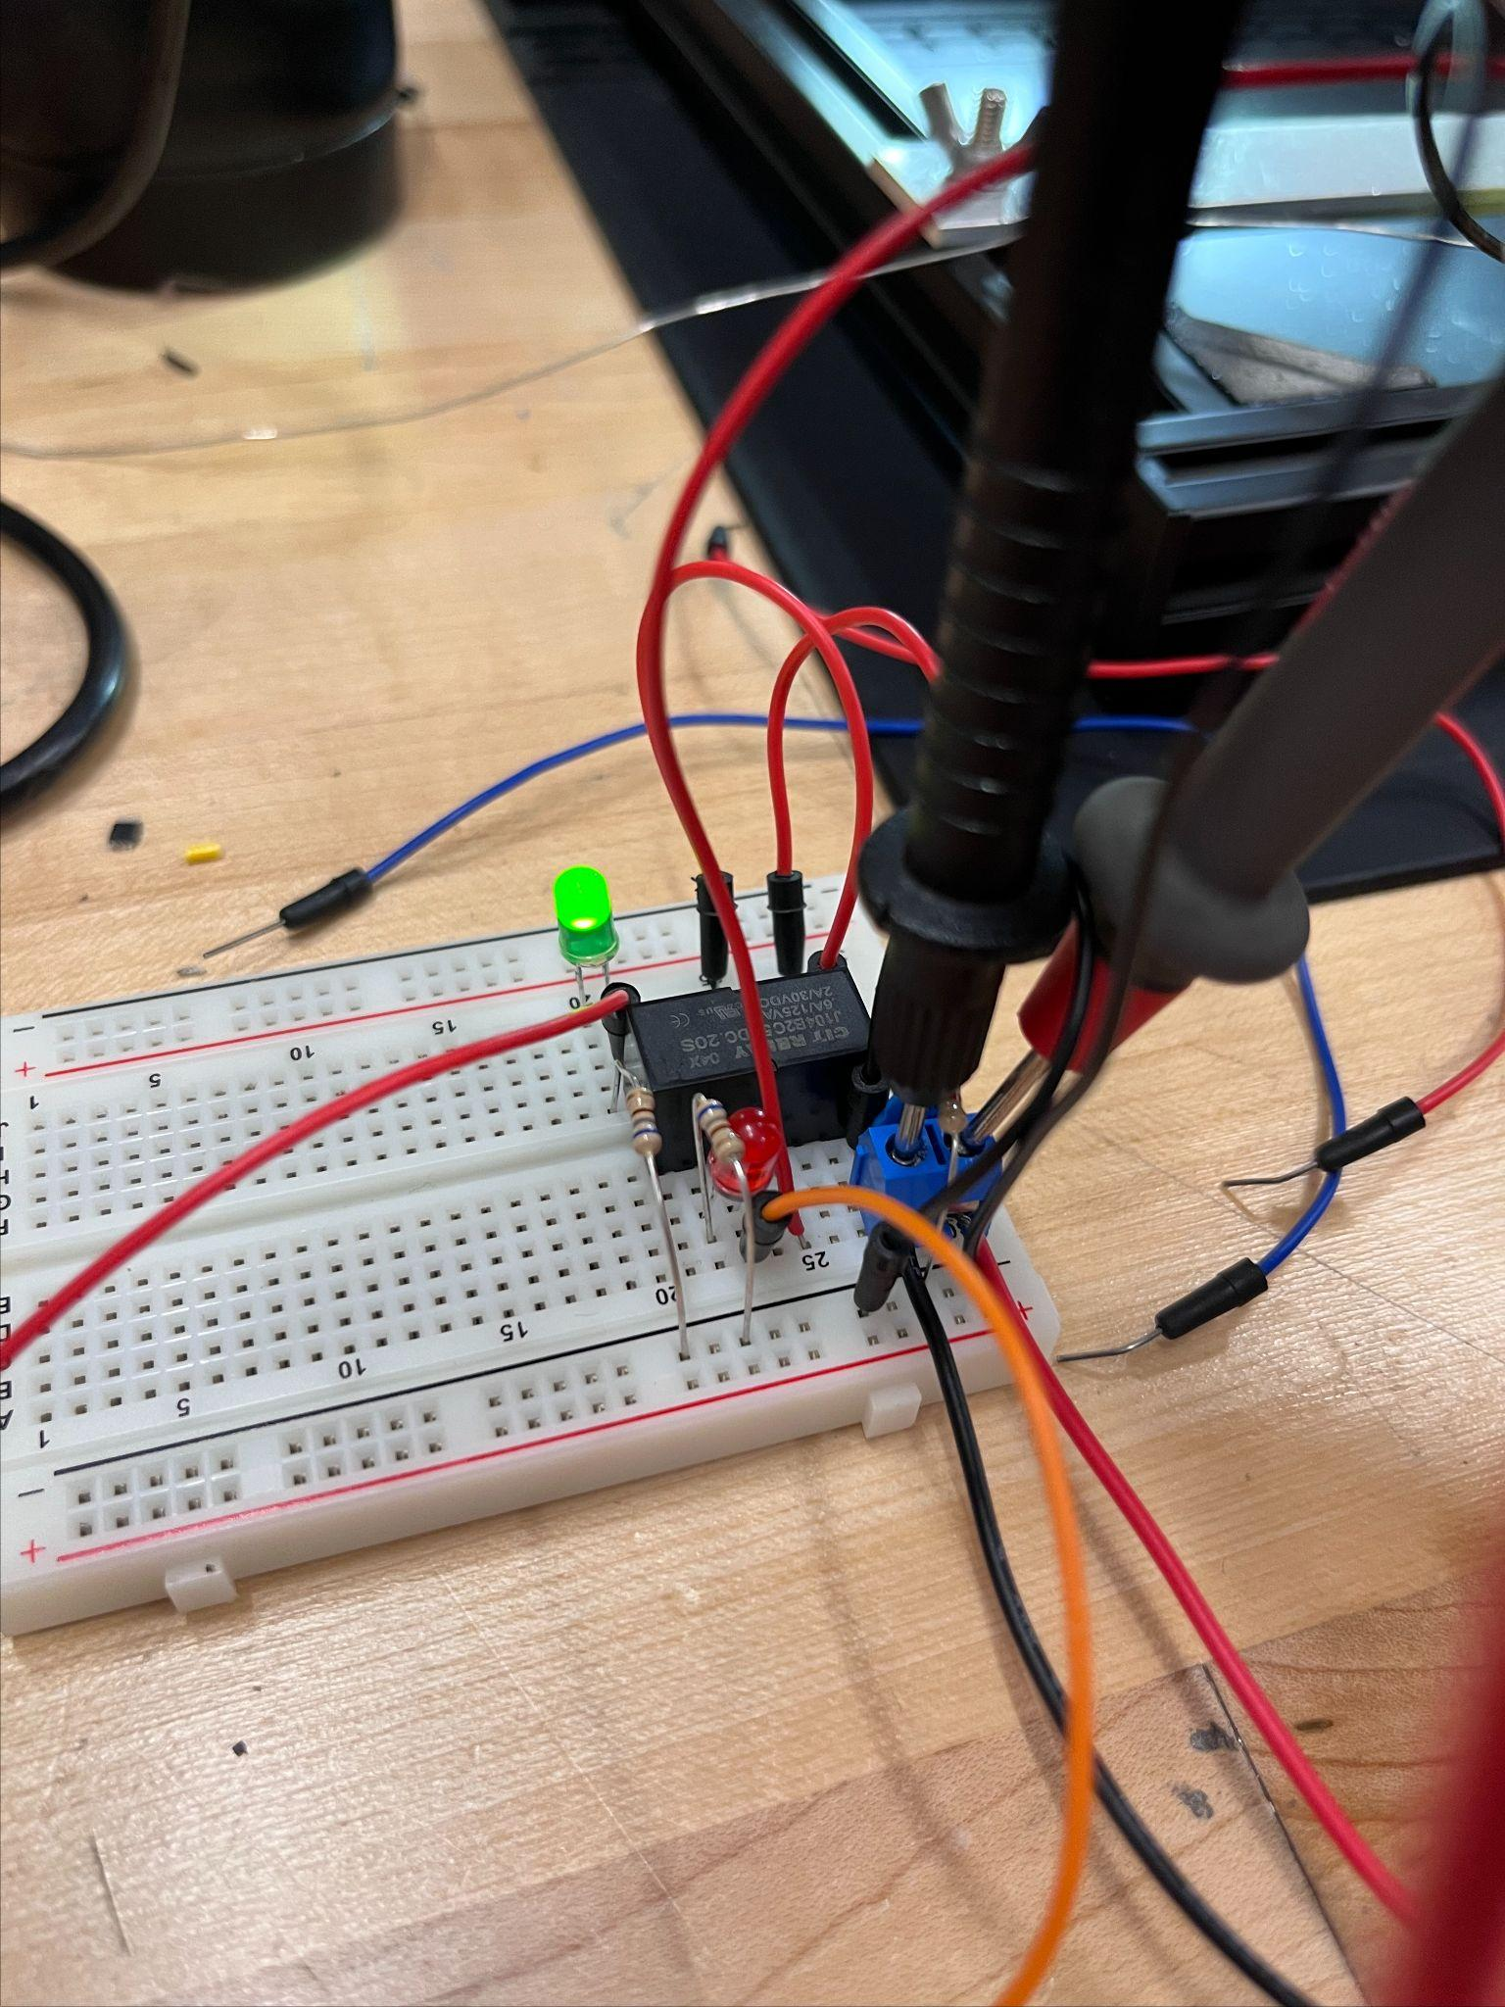
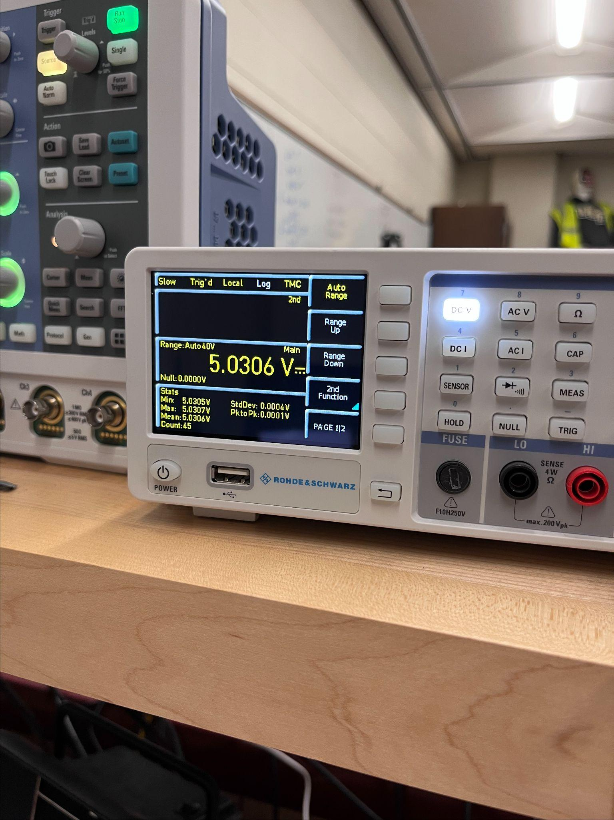
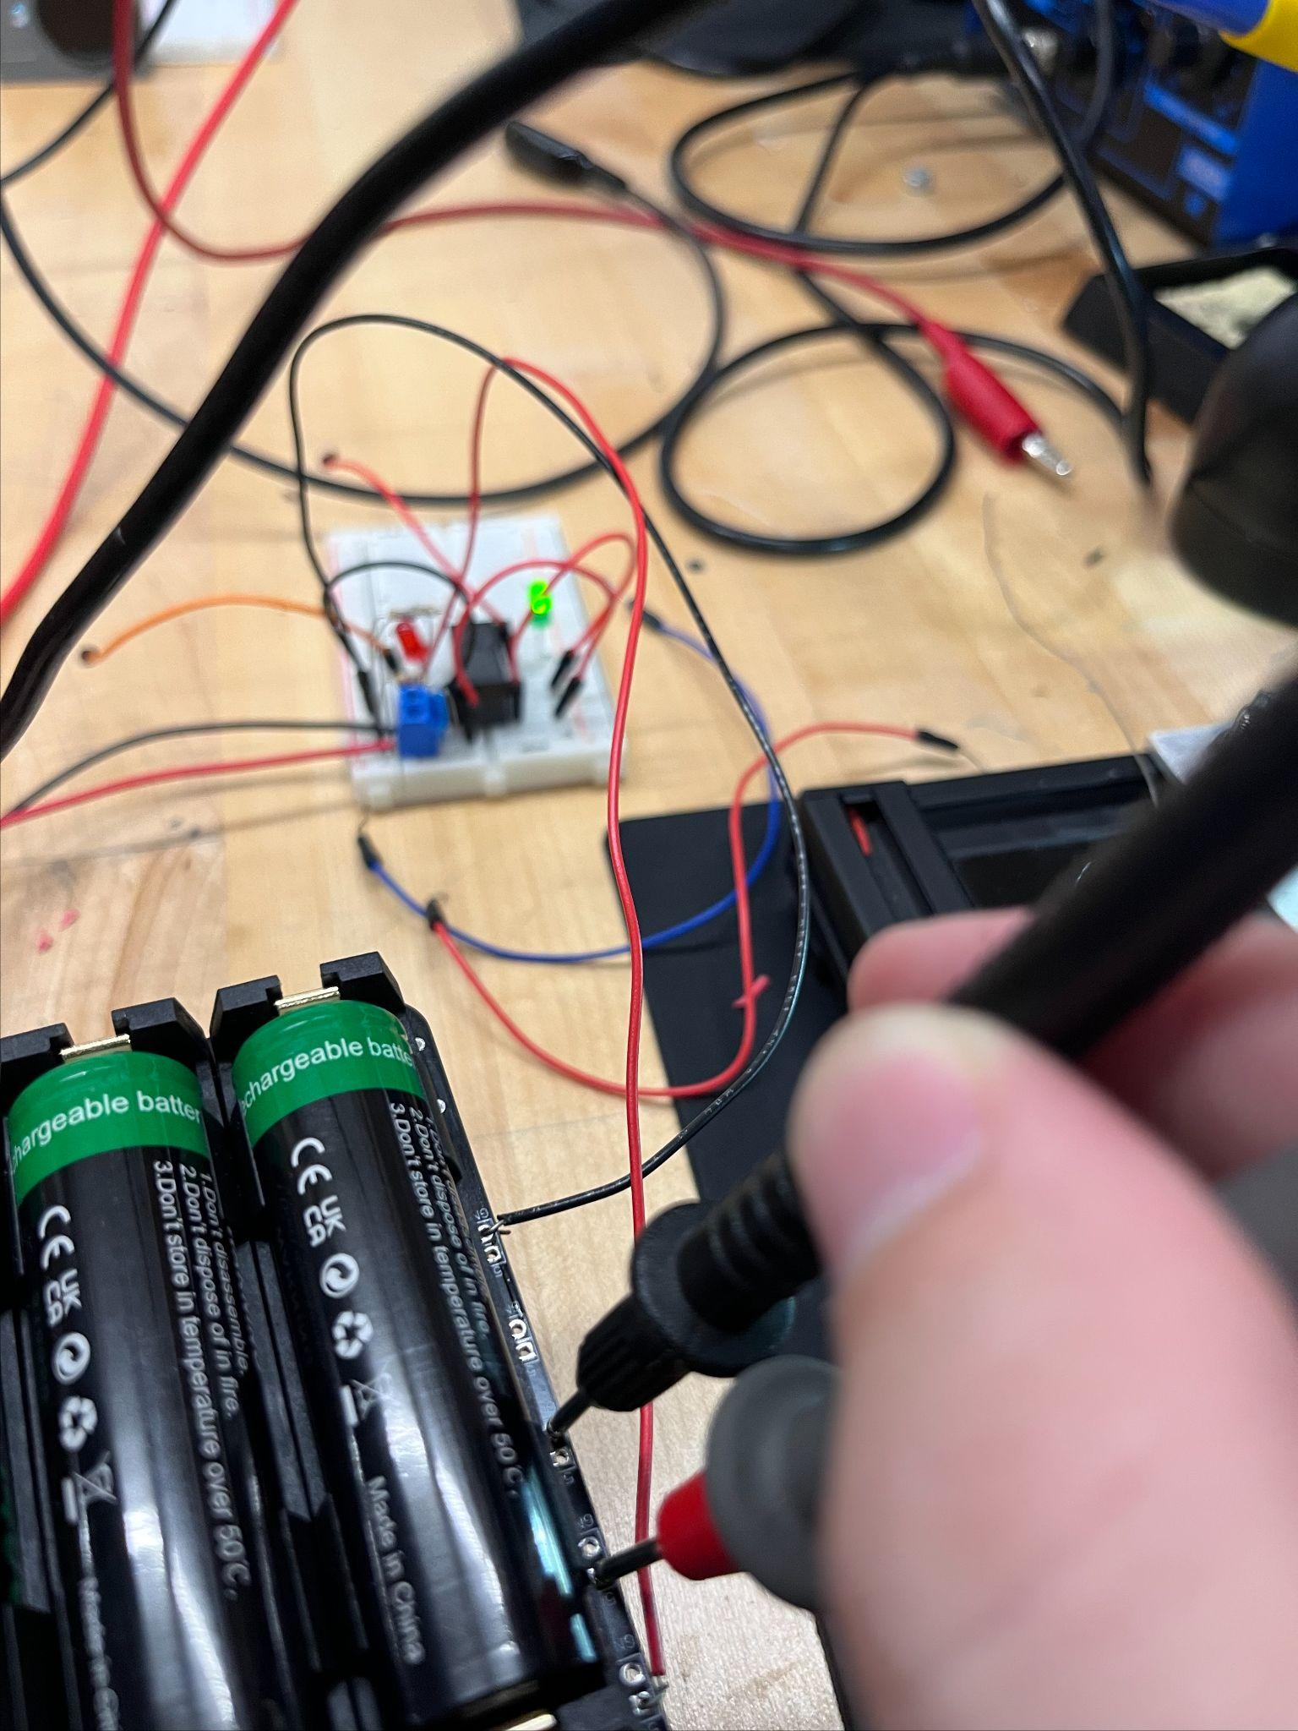
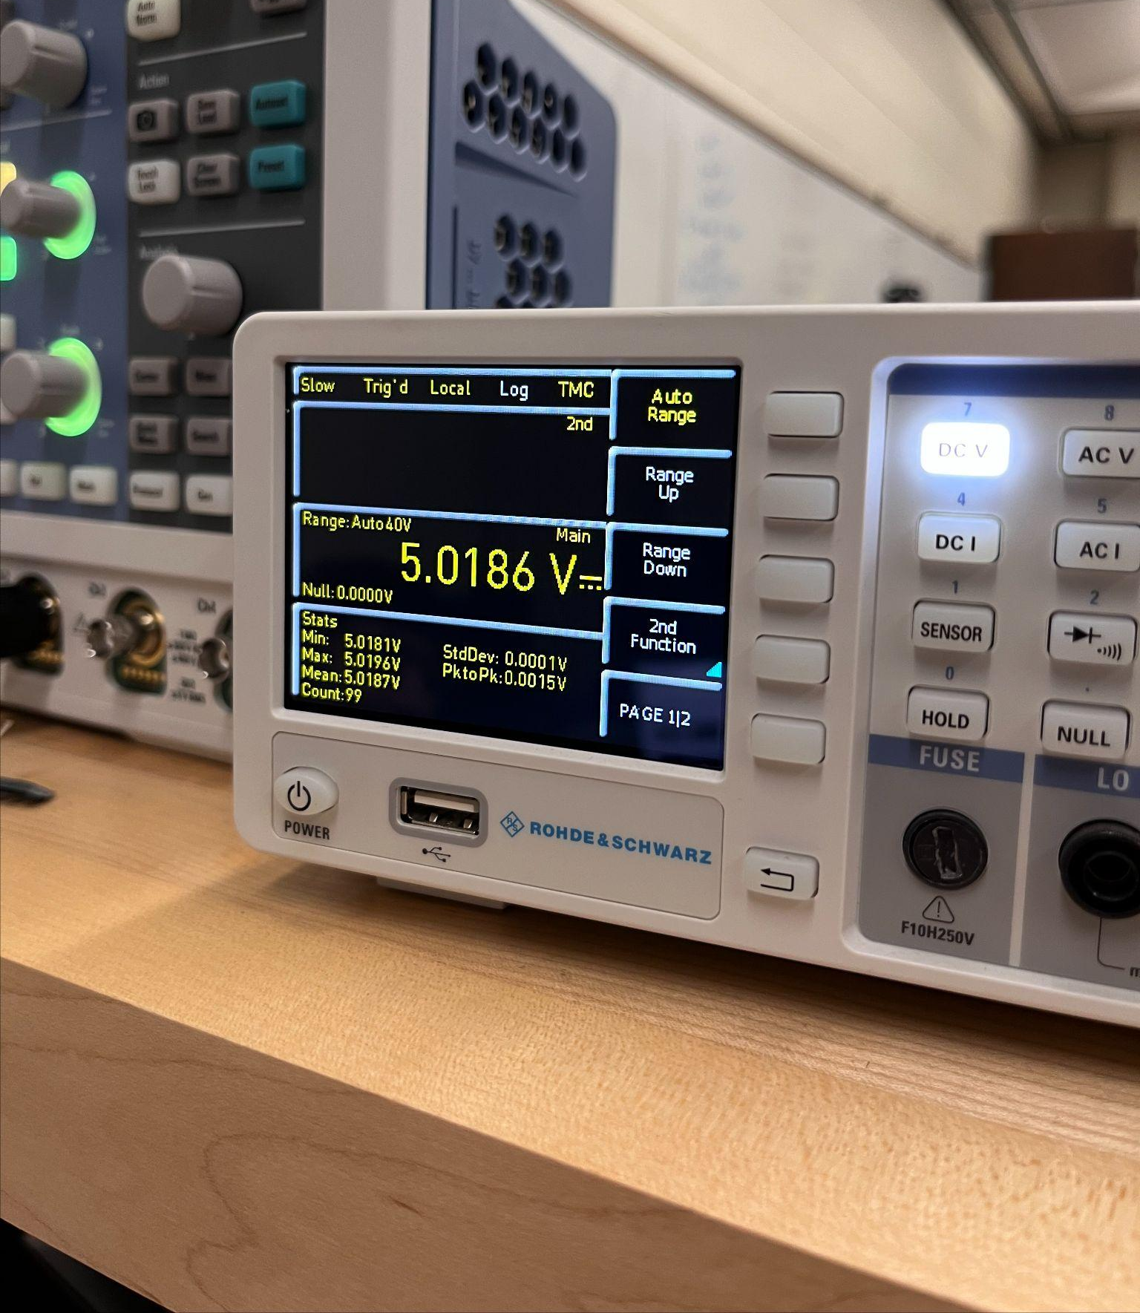
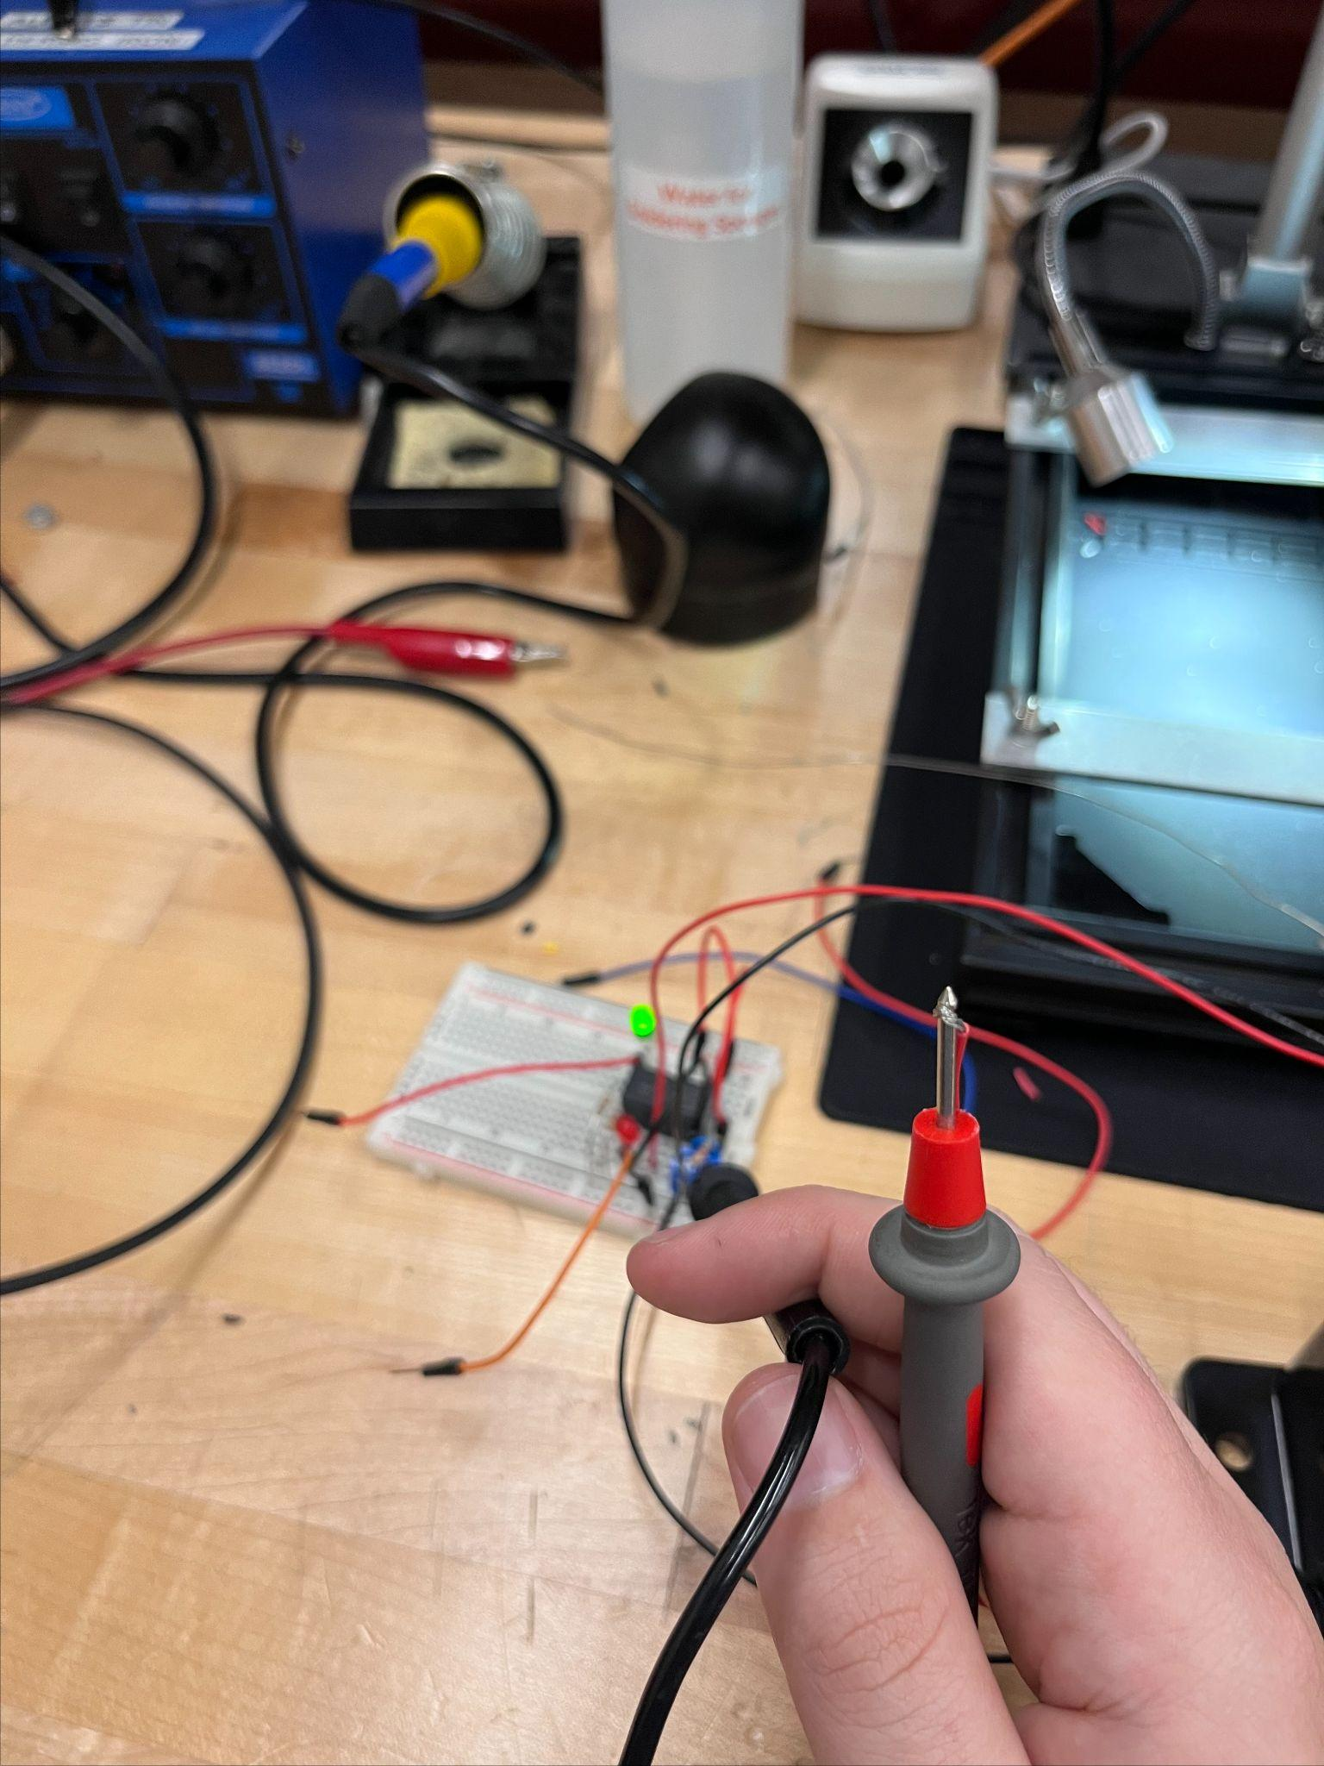
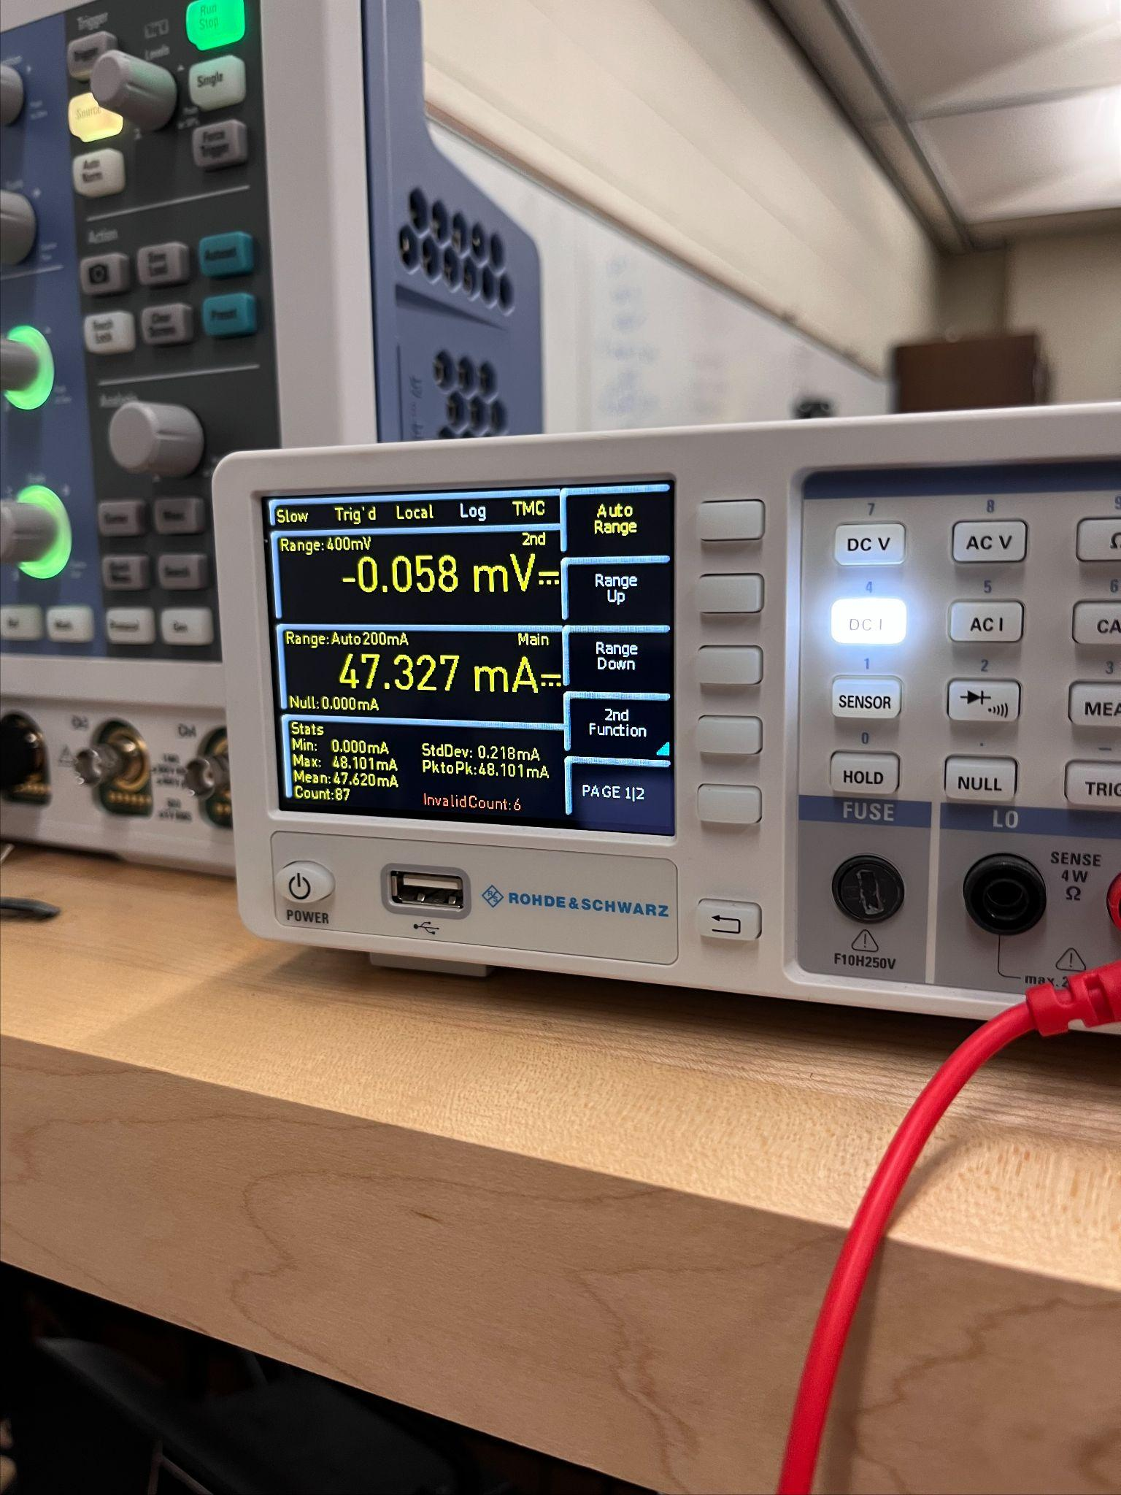
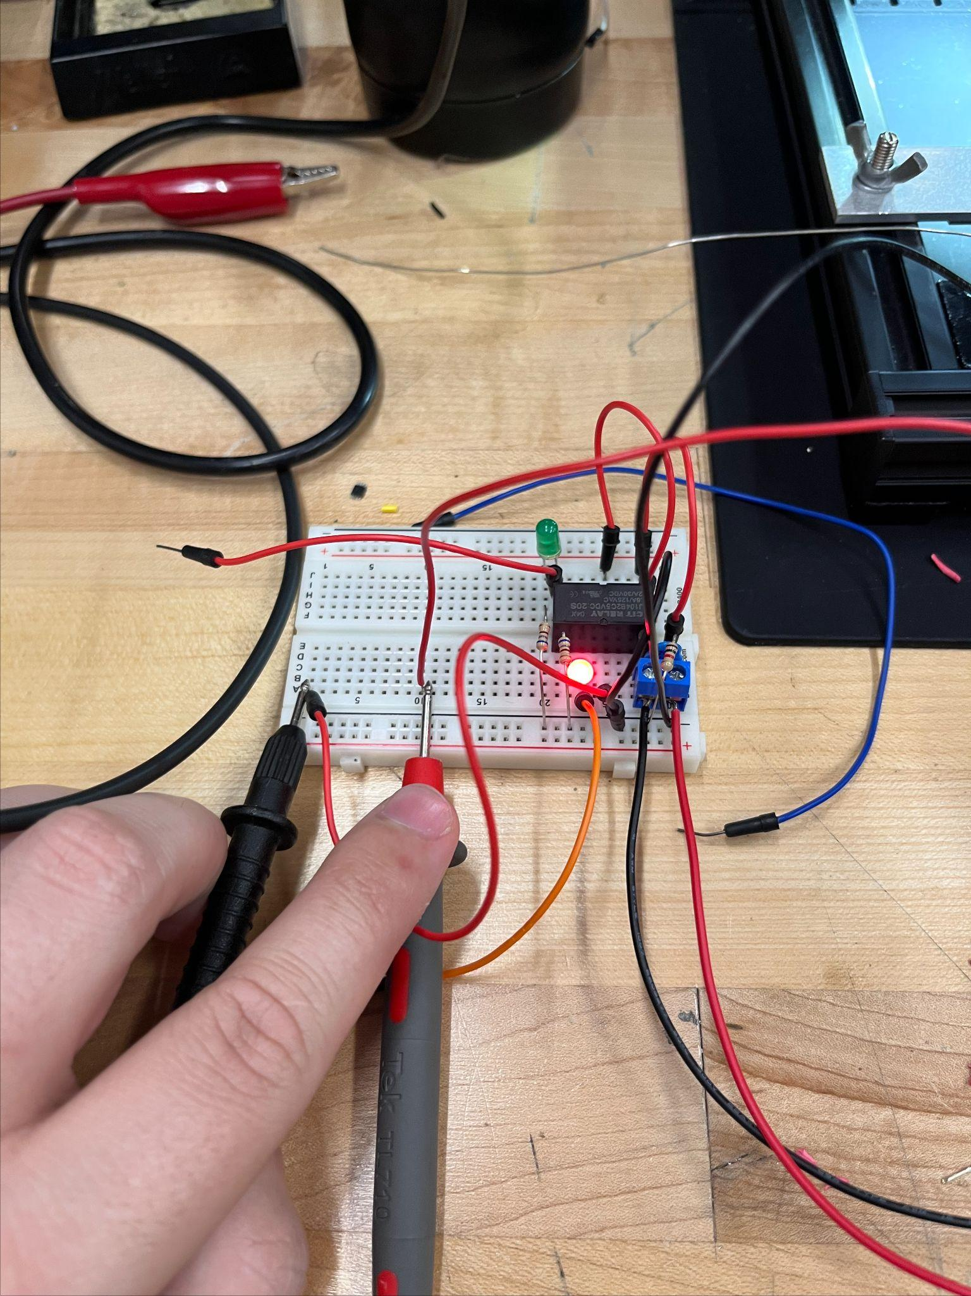

Power Supply Testing
Main Power
Voltage Supply Test
Current Supply Test
(relay load)
Backup Power
Voltage Supply Test
Current Supply Test

Slide 51





Switching System Testing
Yellow: Main Power Green: Backup Power
5V Output
Switch on
Switch off
Green LED: Main power on
Red LED:
Backup power on

Slide 52
Budget
Component Name | Price (USD) | Quantity | Subtotal
Photodiode | $2.60 | 1 | $2.60
LED | $3.00 | 1 | $3.00
Lens | $12.99 | 1 | $12.99
Filter | $35.00 | 1 | $35.00
Camera Module | $10.00 | 1 | $10.00
AC-DC Convertor | $9.73 | 1 | $9.73
Battery | $6.95 | 4 | $27.80
Battery Holder | $9.90 | 1 | $9.90
Relay | $3.30 | 1 | $3.30
Regulator | $1.83 | 1 | $1.83
ESP32-WROOM-32E | $2.50 | 1 | $2.50
Notes:
Andrew F

Slide 53
Work Distribution
Member Name | Tasks
Andrew Forde | PCB Design System Integration MCU Camera Programming Snapshot Technology Integration
Carlos Granja Angulo | Optical System Design Optical System Integration Sensor Calibration and Alignment MCU Signal Processing
Matthew Berasa | MCU Communication Programming Mobile App Development Server, APIs, and Database Integration
Andrew Topliffe | Power System Design AC Power System Design DC Alarm Circuit Hardware Testing
Notes:
Matthew

Slide 54
Progress & Timeline
Completed:
Component selection
Initial designs
Basic testing
App Development
In Progress:
MCU optimization
Optical calibration
App improvement
Remaining Work:
PCB fabrication
Full system integration
Performance optimization
Final testing
Notes:
Carlos

